Slide 1

Accounting & Auditing II
Cost accounting
Job Order Costing

Slide 2

  COST ACCOUNTING CONCEPTS
Manufacturing Costs
Most manufacturing companies separate manufacturing costs into three broad categories:
direct materials, direct labor, and manufacturing overhead
Direct Materials The materials that go into the final product are called raw materials
Direct Labor Direct labor consists of labor costs that can be easily (i.e., physically
and conveniently) traced to individual units of product.
Manufacturing Overhead Manufacturing overhead , the third element of manufacturing cost, includes all manufacturing costs except direct materials and direct labor.
Manufacturing overhead includes items such as indirect materials; indirect labor; maintenance and repairs on production equipment; and heat and light, property taxes, depreciation, and insurance on manufacturing facilities

Slide 3
  COST ACCOUNTING CONCEPTS
Nonmanufacturing Costs
Nonmanufacturing costs are often divided into two categories selling costs and administrative costs.
Selling costs include all costs that are incurred to secure customer
orders and get the finished product to the customer
Administrative costs include all costs associated with the general management of an organization rather than with manufacturing or selling

Slide 4
  COST ACCOUNTING CONCEPTS
Product Costs
For financial accounting purposes, product costs include all costs involved in acquiring or making a product. In the case of manufactured goods, these costs consist of direct materials, direct labor, and manufacturing overhead
Period Costs
Period costs are all the costs that are not product costs. All selling and administrative expenses are treated as period costs. For example, sales commissions, advertising, executive salaries, public relations, and the rental costs of administrative offices are all period costs.

Slide 5
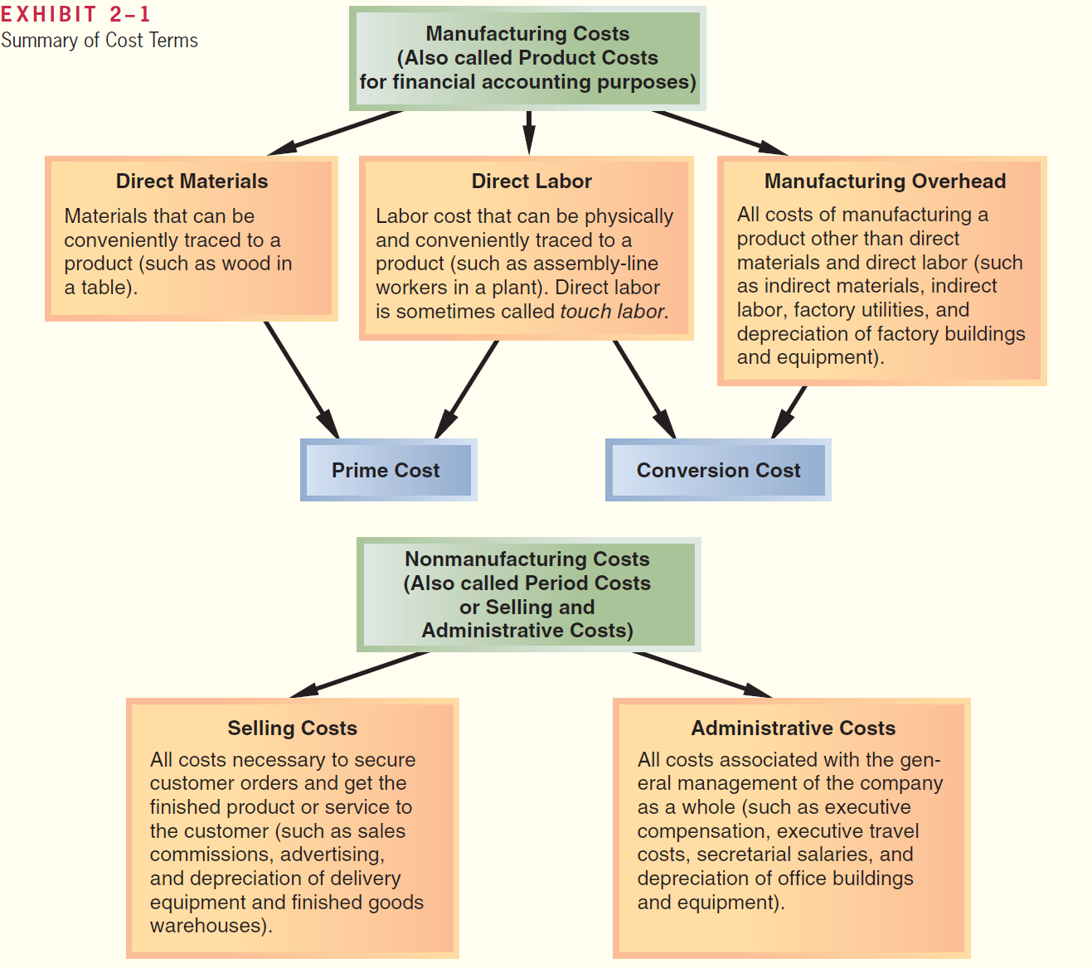
  COST ACCOUNTING CONCEPTS

Slide 6
  COST ACCOUNTING CONCEPTS
Variable Cost
A variable cost varies, in total, in direct proportion to changes in the level of activity. Common examples of variable costs include cost of goods sold for a merchandising company, direct materials, direct labor, variable elements of manufacturing overhead, such as indirect materials, supplies, and power, and variable elements of selling and administrative expenses, such as commissions and shipping costs.
Fixed Cost
A fixed cost is a cost that remains constant, in total, regardless of changes in the level of activity. Examples of fixed costs include straight-line depreciation, insurance, property taxes, rent, supervisory salaries, administrative salaries, and advertising

Slide 7
  COST ACCOUNTING CONCEPTS
Variable Cost
A variable cost varies, in total, in direct proportion to changes in the level of activity. Common examples of variable costs include cost of goods sold for a merchandising company, direct materials, direct labor, variable elements of manufacturing overhead, such as indirect materials, supplies, and power, and variable elements of selling and administrative expenses, such as commissions and shipping costs.
Fixed Cost
A fixed cost is a cost that remains constant, in total, regardless of changes in the level of activity. Examples of fixed costs include straight-line depreciation, insurance, property taxes, rent, supervisory salaries, administrative salaries, and advertising

Slide 8
  COST ACCOUNTING CONCEPTS
Variable Cost
A variable cost varies, in total, in direct proportion to changes in the level of activity. Common examples of variable costs include cost of goods sold for a merchandising company, direct materials, direct labor, variable elements of manufacturing overhead, such as indirect materials, supplies, and power, and variable elements of selling and administrative expenses, such as commissions and shipping costs.
Fixed Cost
A fixed cost is a cost that remains constant, in total, regardless of changes in the level of activity. Examples of fixed costs include straight-line depreciation, insurance, property taxes, rent, supervisory salaries, administrative salaries, and advertising

Slide 9
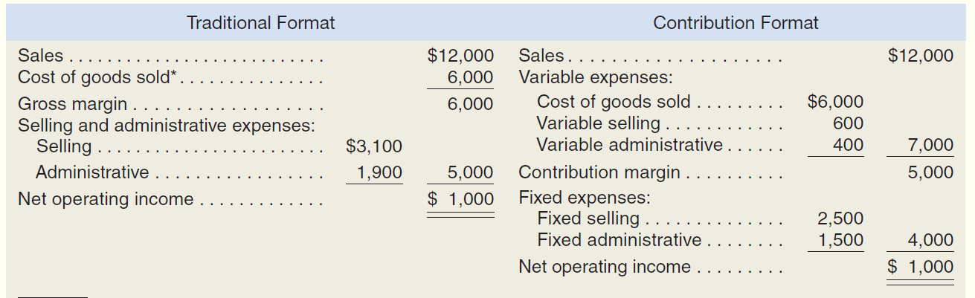
  Traditional and Contribution Format Income Statements

Slide 10
  Job Order Costing
Job-order costing is used in situations where many different products are produced each period.
For example, a Levi Strauss clothing factory would typically make many different types of jeans for both men and women during a month. A particular order might consist of 1,000 boot-cut men’s blue denim jeans, style number A312. This order of 1,000 jeans is called a job. In a job-order costing system, costs are traced and allocated to jobs and then the costs of the job are divided by the number of units in the job to arrive at an average cost per unit.

Slide 11
  Job Order Costing
Measuring Direct Materials Cost
A bill of materials is a document that lists the type and quantity of each type of direct material needed to complete a unit of product.
Measuring Direct Labor Cost
Direct labor consists of labor charges that are easily traced to a particular job. Labor charges that cannot be easily traced directly to any job are treated as part of manufacturing overhead
Computing Predetermined Overhead Rates
Manufacturing overhead also needs to be recorded on the job cost sheet. However, assigning manufacturing overhead to a specific job involves some difficulties.
There are three reasons for this:
Manufacturing overhead is an indirect cost.
Manufacturing overhead consists of many different items.
Because of the fixed costs in manufacturing overhead, total manufacturing overhead costs tend to remain relatively constant from one period to the next even though the number of units produced can fluctuate widely. Consequently, the average cost per unit will vary from one period to the next.

Slide 12
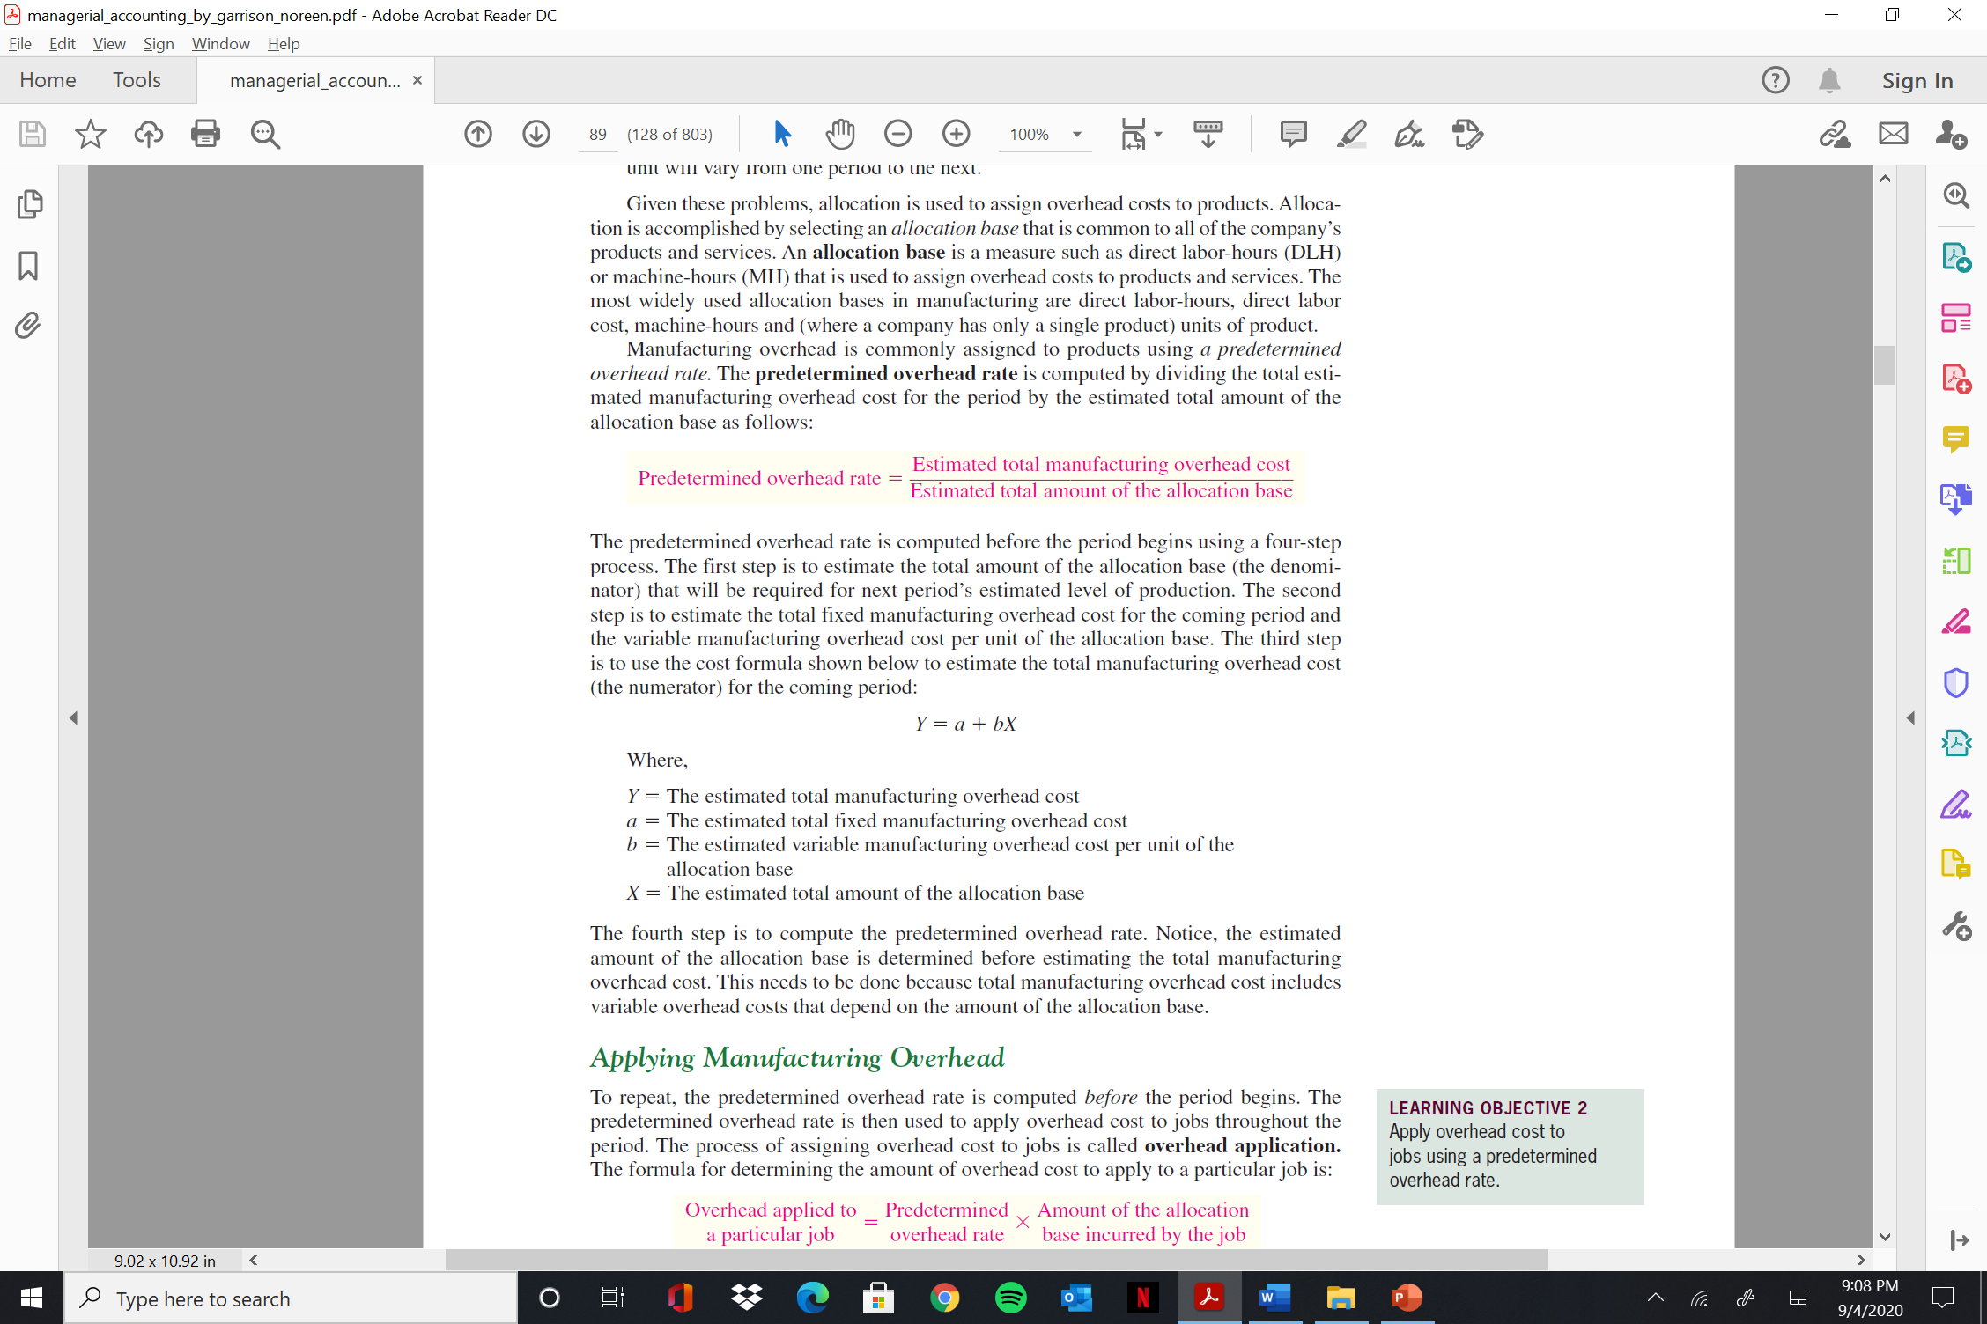
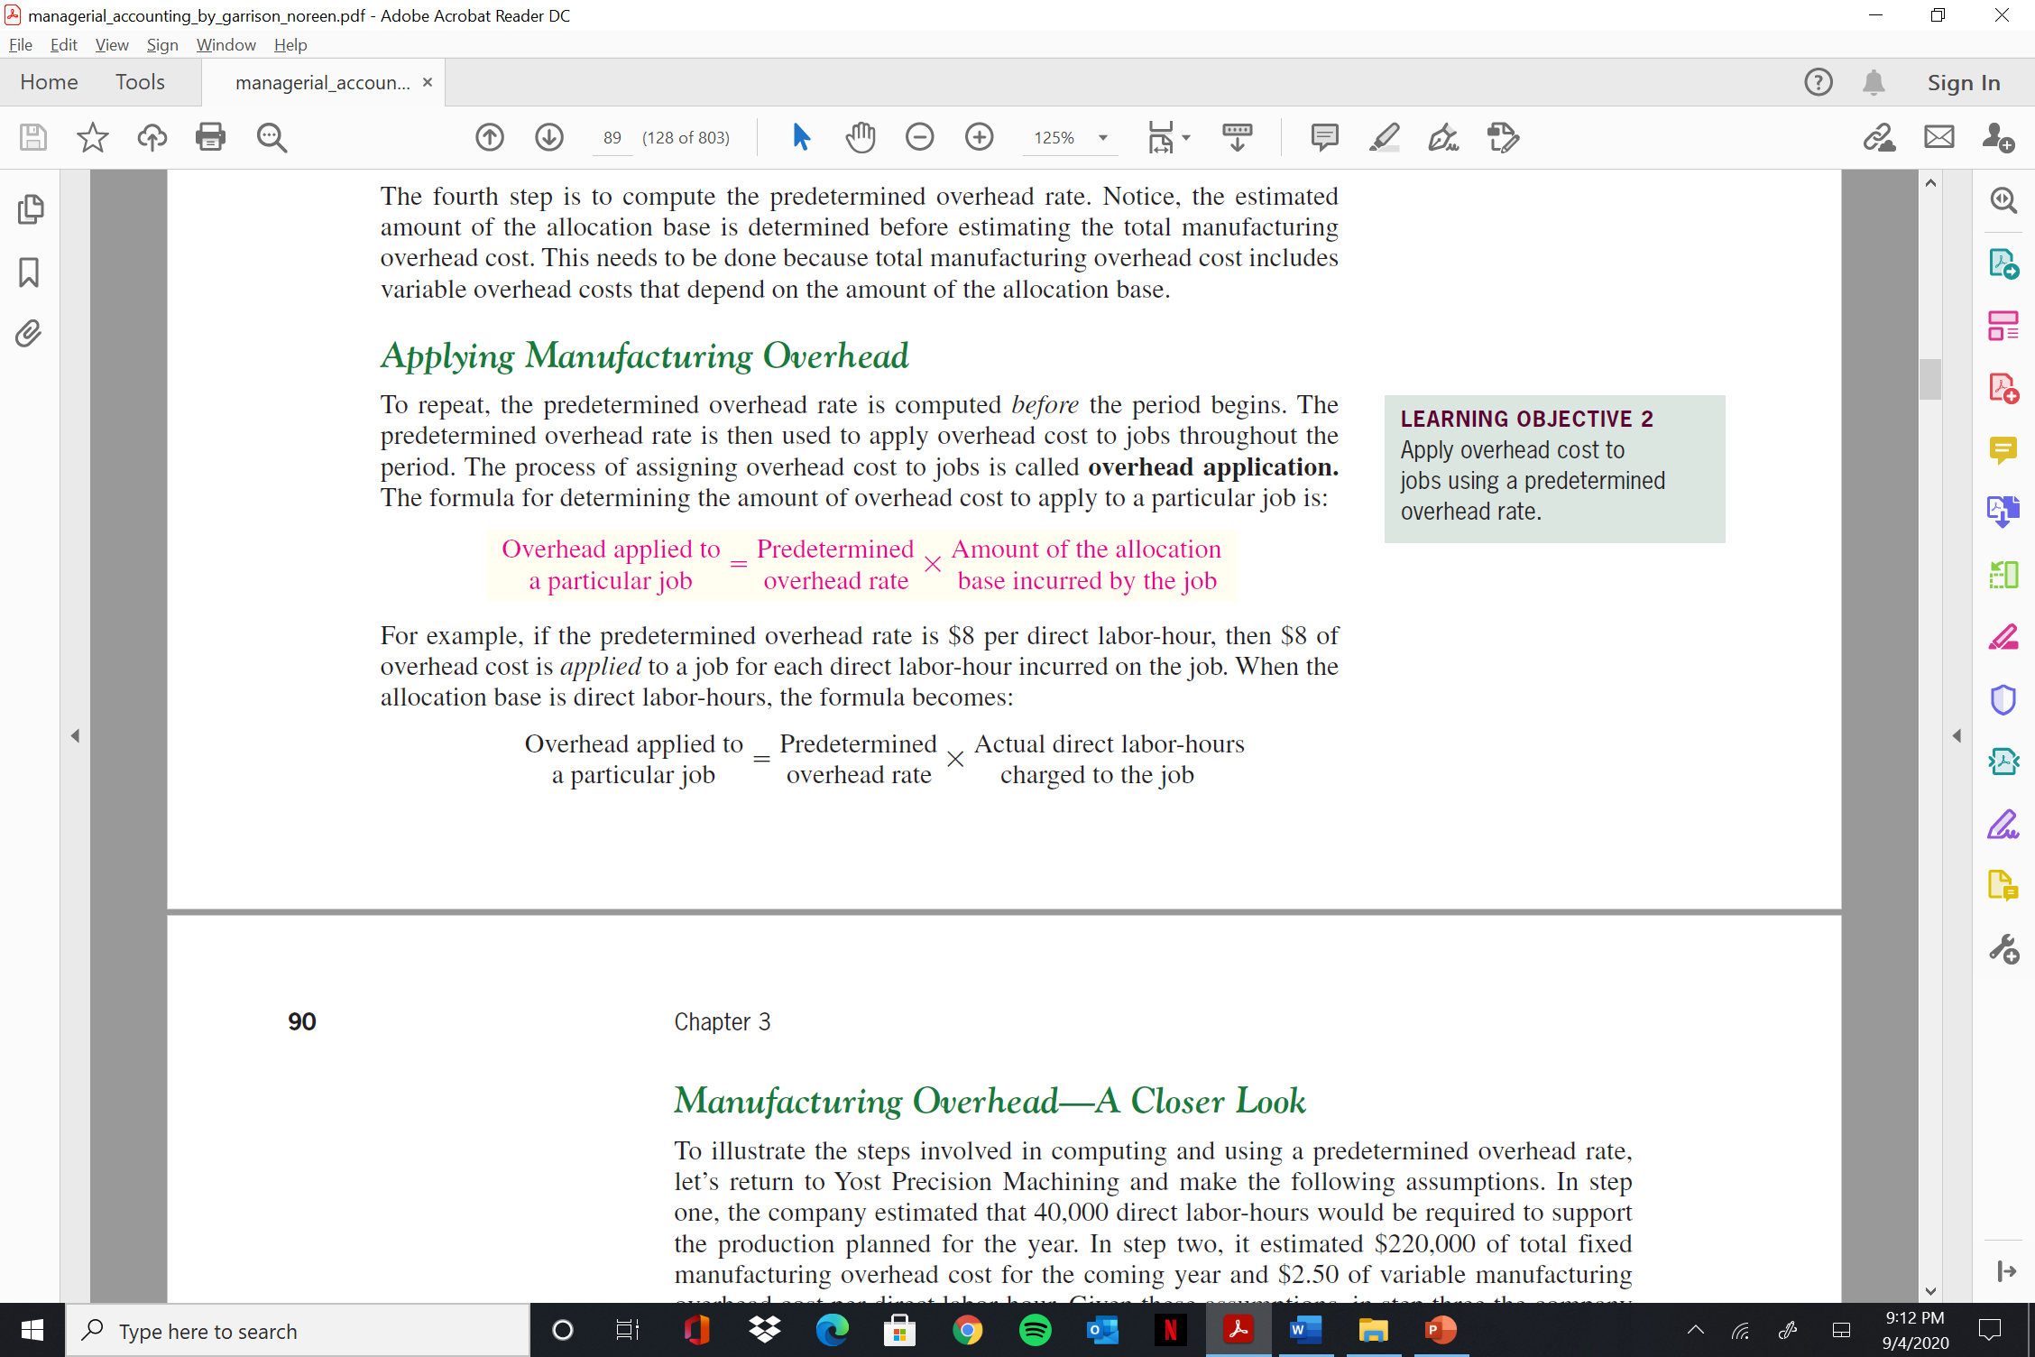
  Job Order Costing
Manufacturing overhead is commonly assigned to products using a predetermined overhead rate. The predetermined overhead rate is computed by dividing the total estimated manufacturing overhead cost for the period by the estimated total amount of the
allocation base as follows:
Applying Manufacturing Overhead

Slide 13
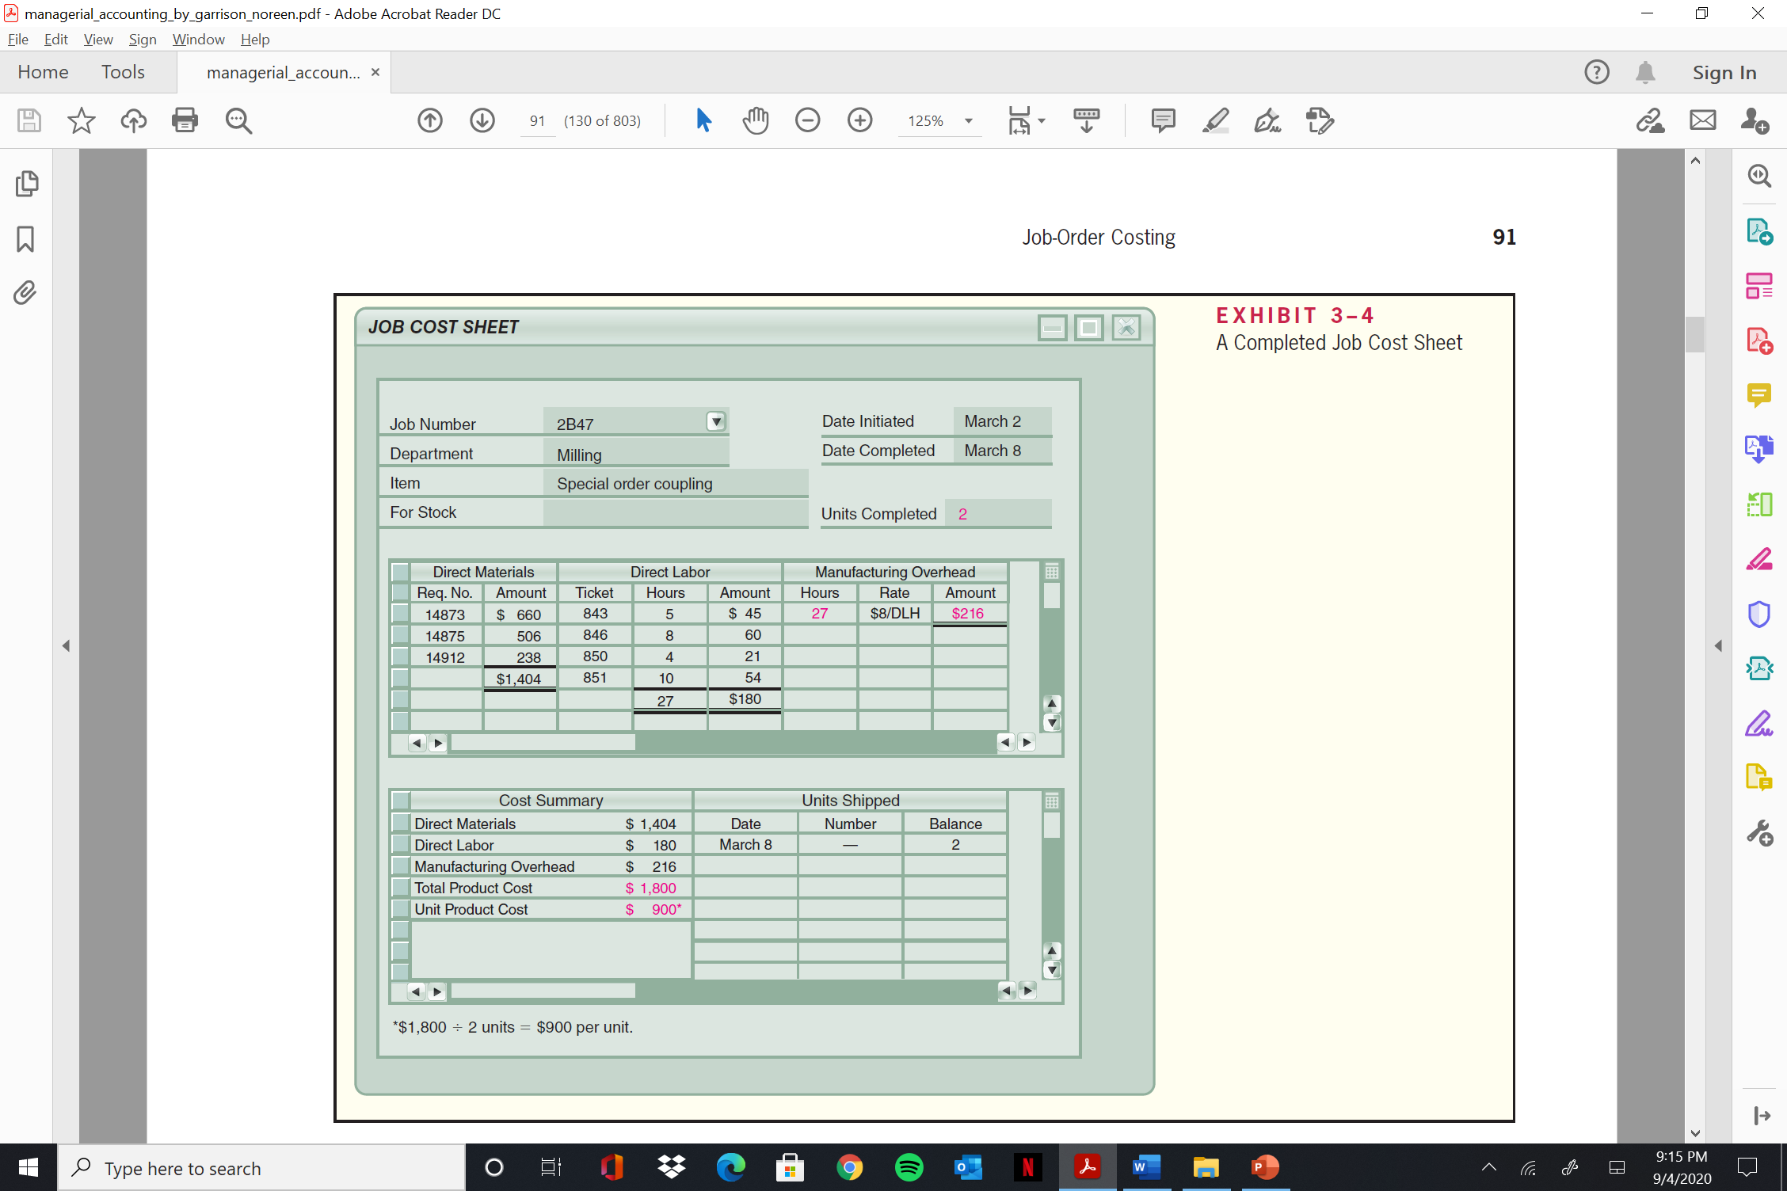
  Job Order Costing
Job Cost Sheet

Slide 14
  Job Order Costing
The Purchase of MATERIALS
On April 1, Ruger Corporation had $7,000 in raw materials on hand. During the month, the company purchased on account an additional $60,000 in raw materials. The purchase is recorded in journal entry
Raw Materials . . . . Dr. . . . . . . . . . . . . . . . . . . . . . . . . . . . . . . . . . . . . . .60,000
Accounts Payable . Cr. . . . . . . . . . . . . . . . . . . . . . . . . . . . . . . . . 60,000
ISSUE OF DIRECT AND INDIRECT MATERIALS
During April, $52,000 in raw materials were requisitioned from the storeroom for use in production. These raw materials included $50,000 of direct and $2,000 of indirect materials
Work in Process . . . . . . . . Dr. . . . . . . . . . . . . . . . . . . .. . . . . . . . . . . . . . . 50,000
Manufacturing Overhead . .Dr . . . . . . . . . . . . . . . . . .. . . . . . . . . . . . . . . . 2,000
Raw Materials . . . . . . . . . . Cr. . . . . . . . . . . . . . .. . . . . . . . . . . . . . 52,000
LABOR COST
In April, the employee time tickets included $60,000 recorded for direct labor and $15,000 for indirect labor. The following entry summarizes these costs
Work in Process . . . . . . . . . . . . . . . . . . . . . . . . . . . . . . . . . . . . . . . . . . 60,000
Manufacturing Overhead . . . . . . . . . . . . . . . . . . . . . . .. . . . . . . . . . . . 15,000
Salaries and Wages Payable . . . . . . . . . . . . . . . . . . . . . . . . . . 75,000

Slide 15
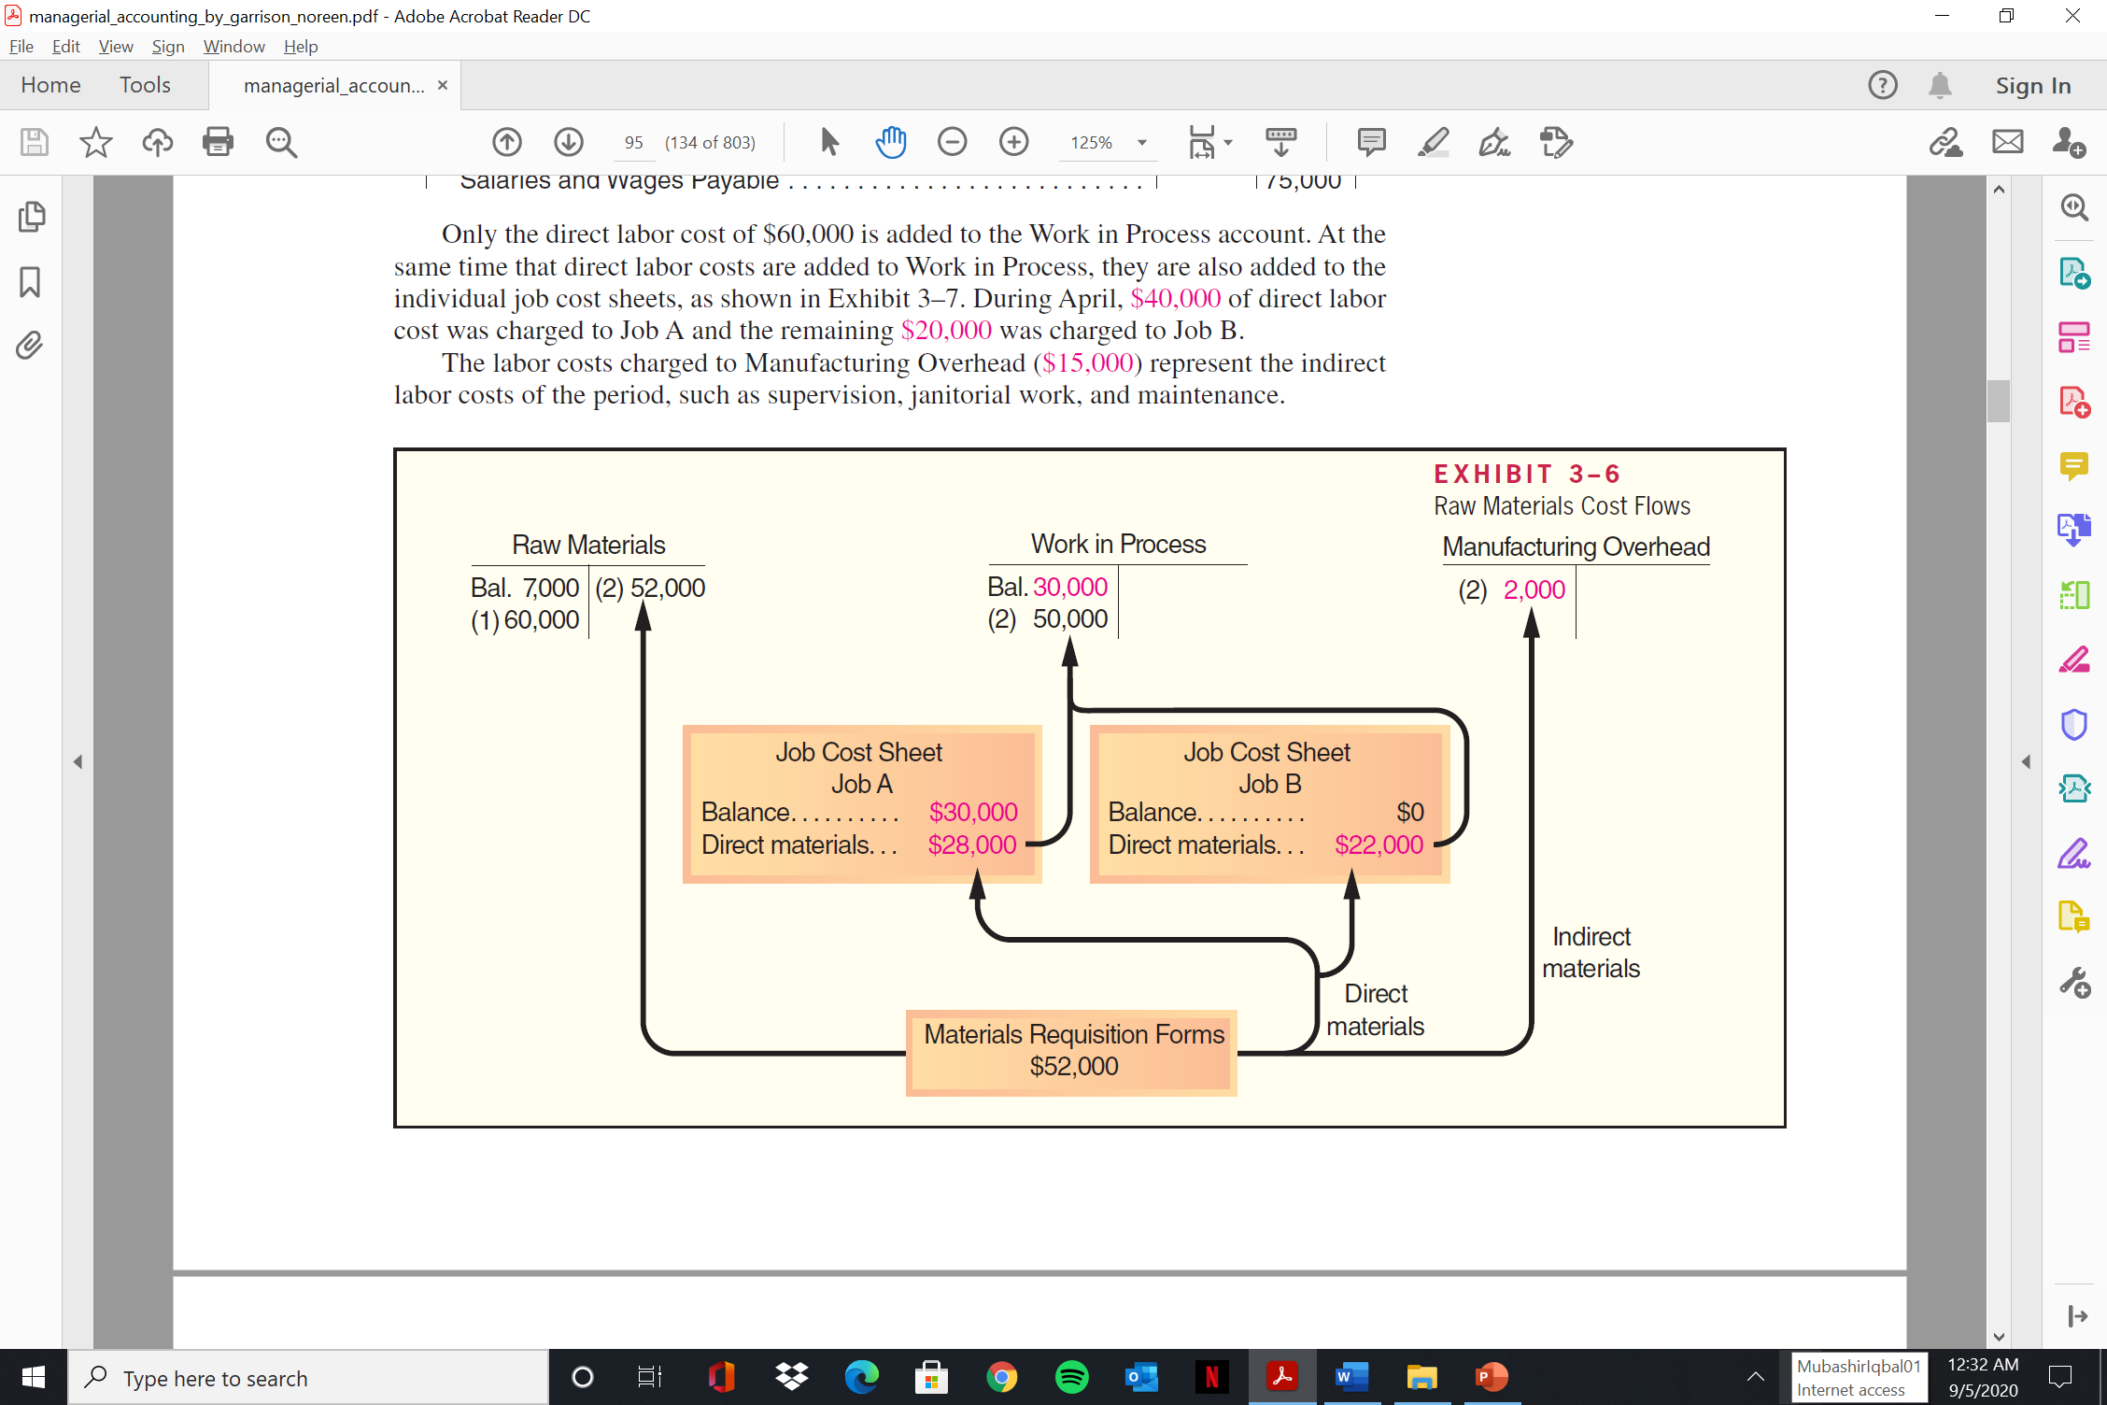
  Job Order Costing

Slide 16
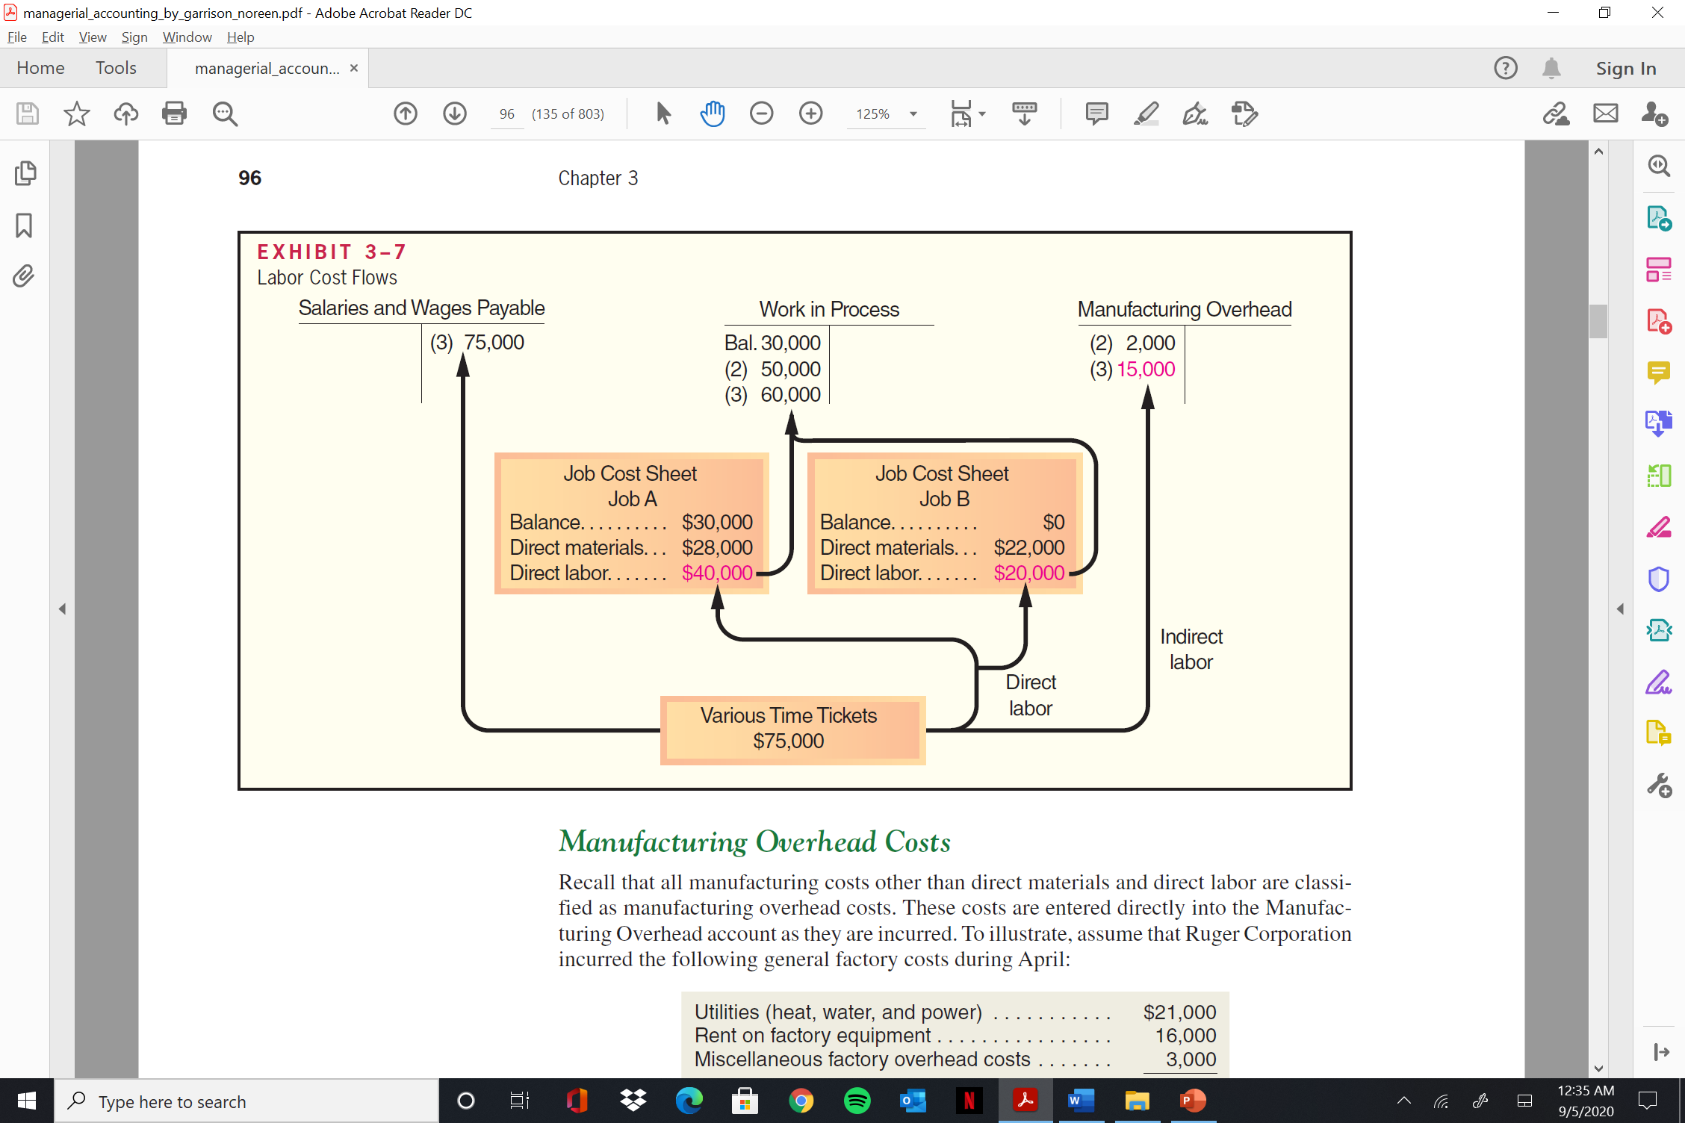
  Job Order Costing

Slide 17
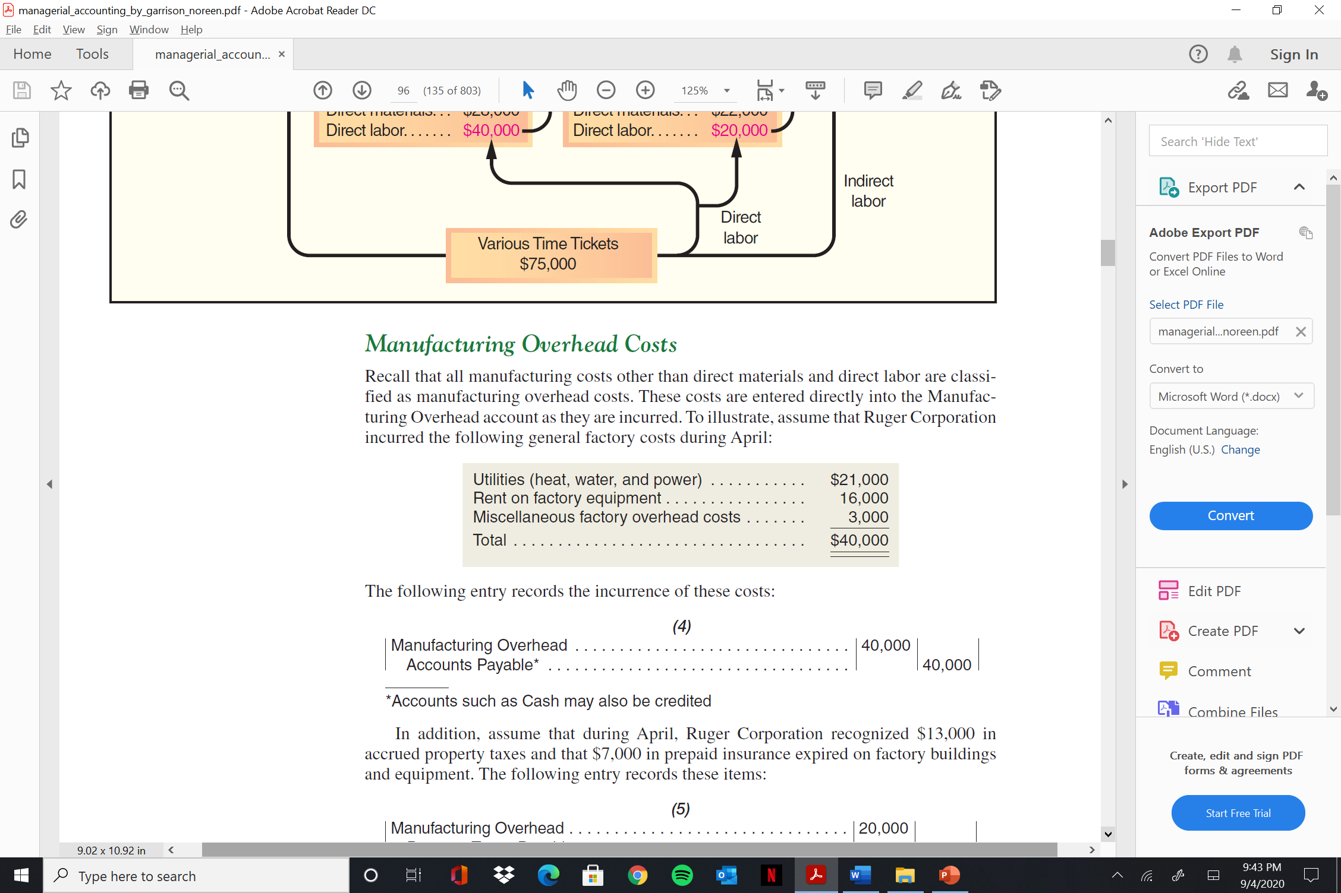
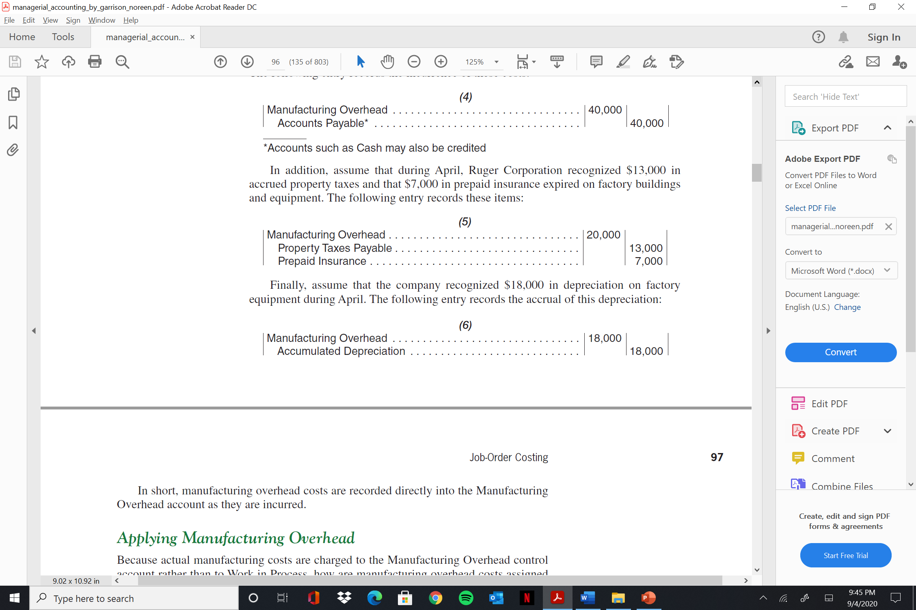
  Job Order Costing
Manufacturing Overhead Costs
Recall that all manufacturing costs other than direct materials and direct labor are classified
as manufacturing overhead costs.

Slide 18
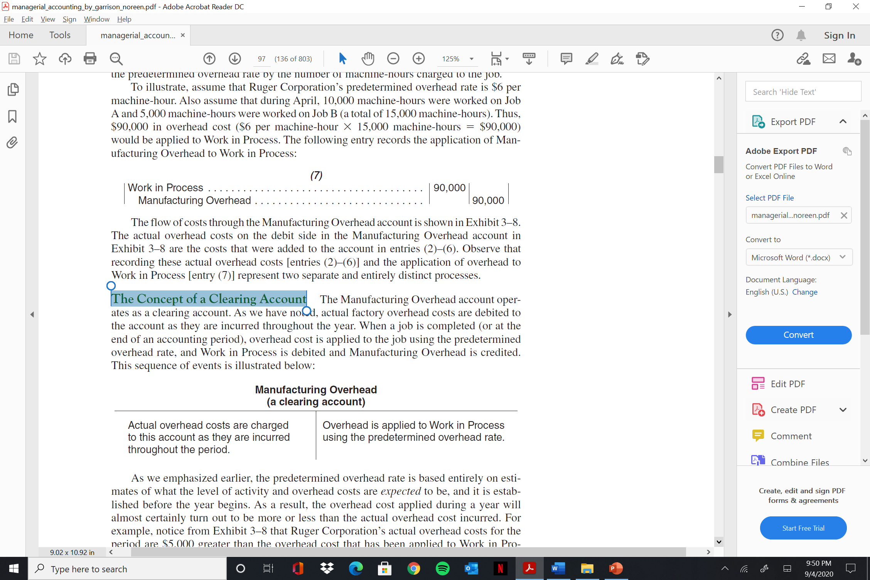
  Job Order Costing
Applying Manufacturing Overhead
To illustrate, assume that Ruger Corporation’s predetermined overhead rate is $6 per machine-hour. Also assume that during April, 10,000 machine-hours were worked on Job A and 5,000 machine-hours were worked on Job B (a total of 15,000 machine-hours). Thus, $90,000 in overhead cost ($6 per machine-hour × 15,000 machine-hours = $90,000) would be applied to Work in Process. The following entry records the application of Manufacturing Overhead to Work in Process:
(7)
Work in Process . . . . . . . . . . . . . . . . . . . . . . . . . . . . . . . . . . . . . . . . . . . . 90,000
Manufacturing Overhead . . . . . . . . . . . . . . . . . . . . . . . . . . . . . 90,000
The Concept of a Clearing Account

Slide 19
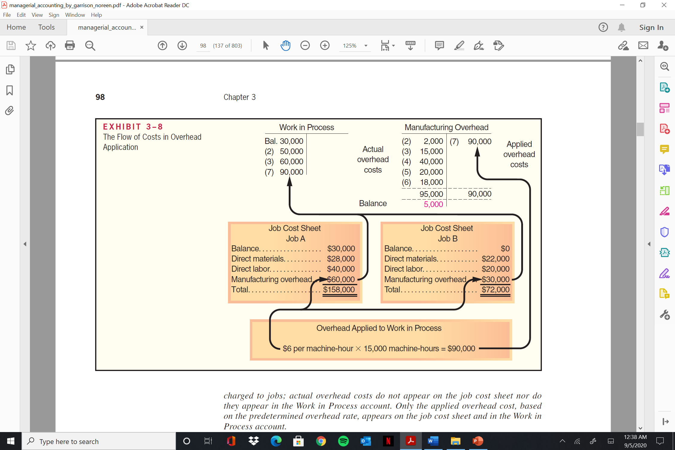
  Job Order Costing

Slide 20
  Job Order Costing
Actual overhead costs are not charged to jobs; actual overhead costs do not appear on the job cost sheet nor do they appear in the Work in Process account. Only the applied overhead cost, based on the predetermined overhead rate, appears on the job cost sheet and in the Work in Process account.

Slide 21
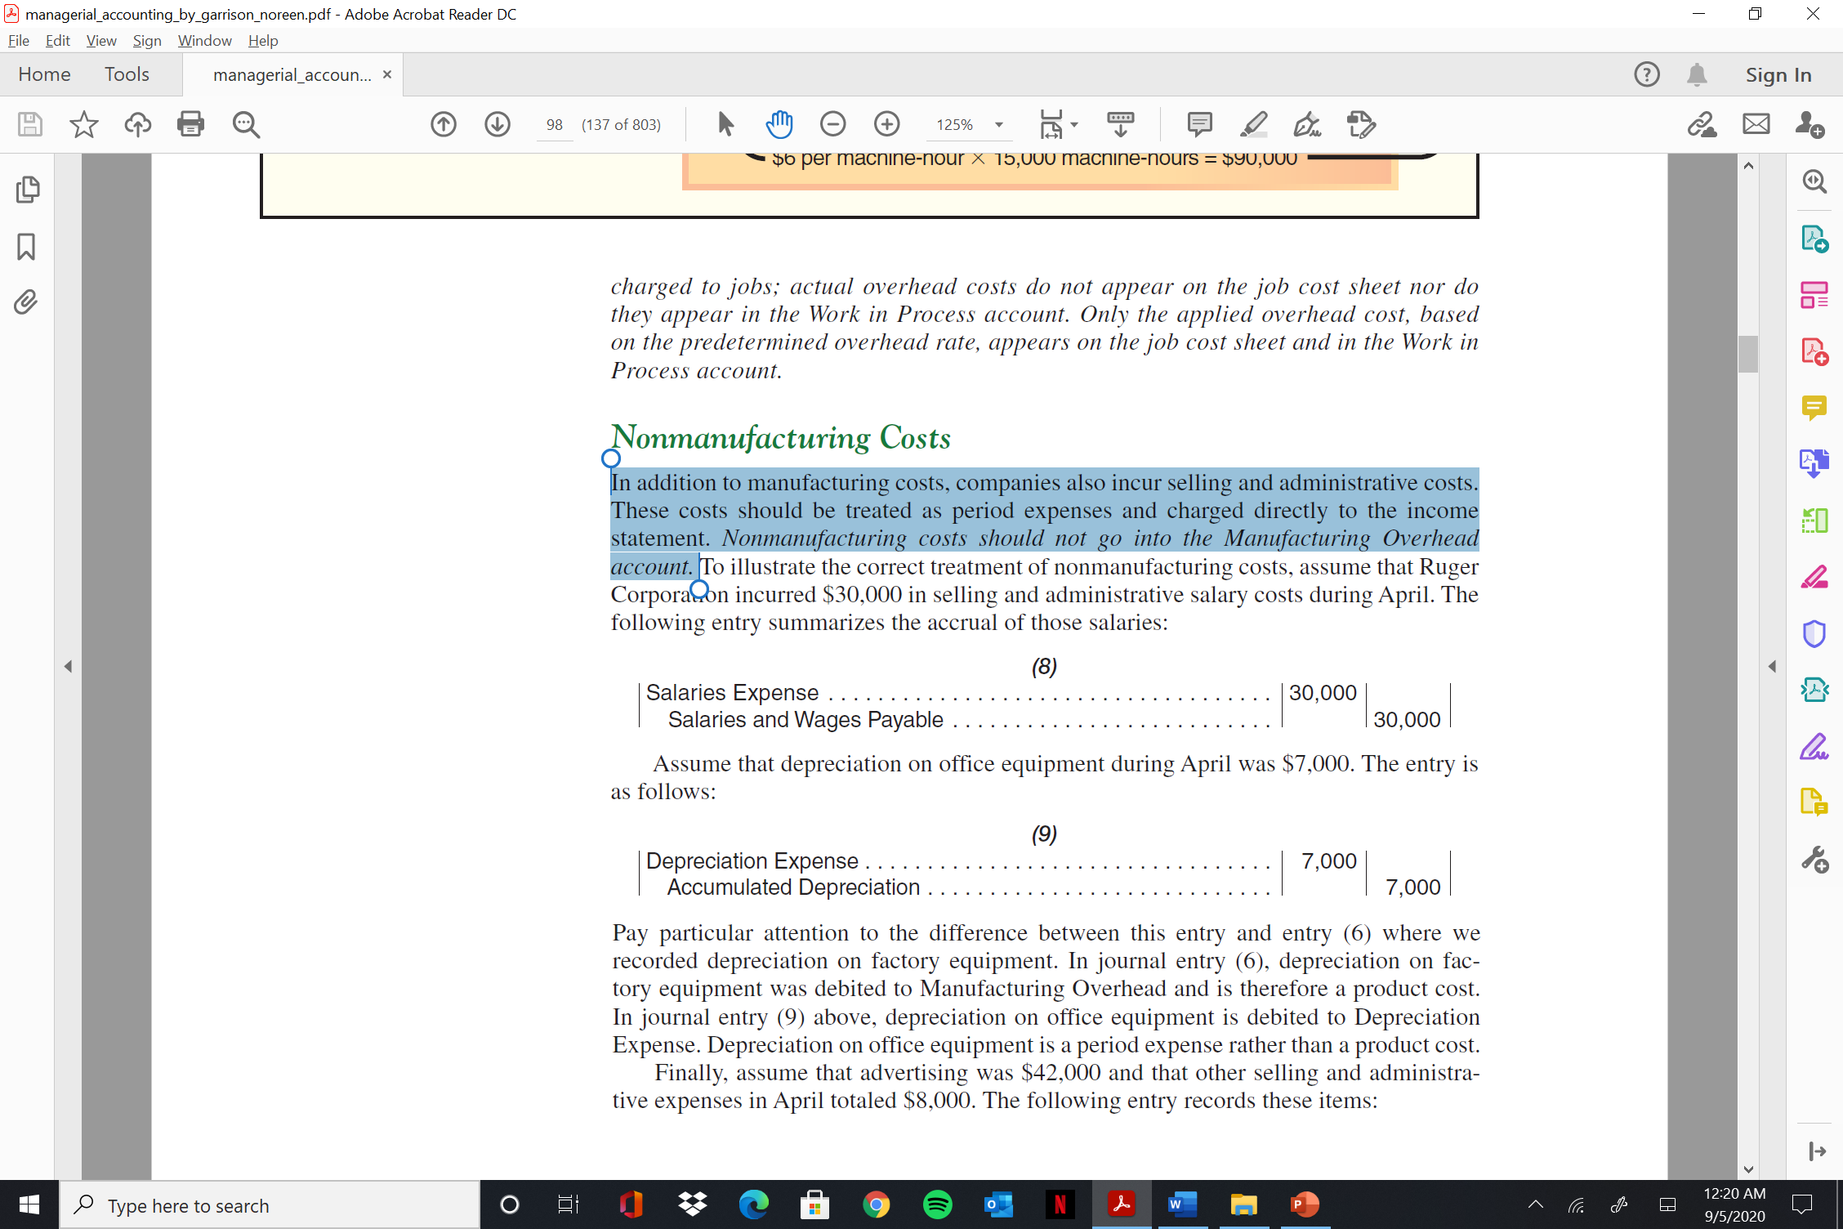
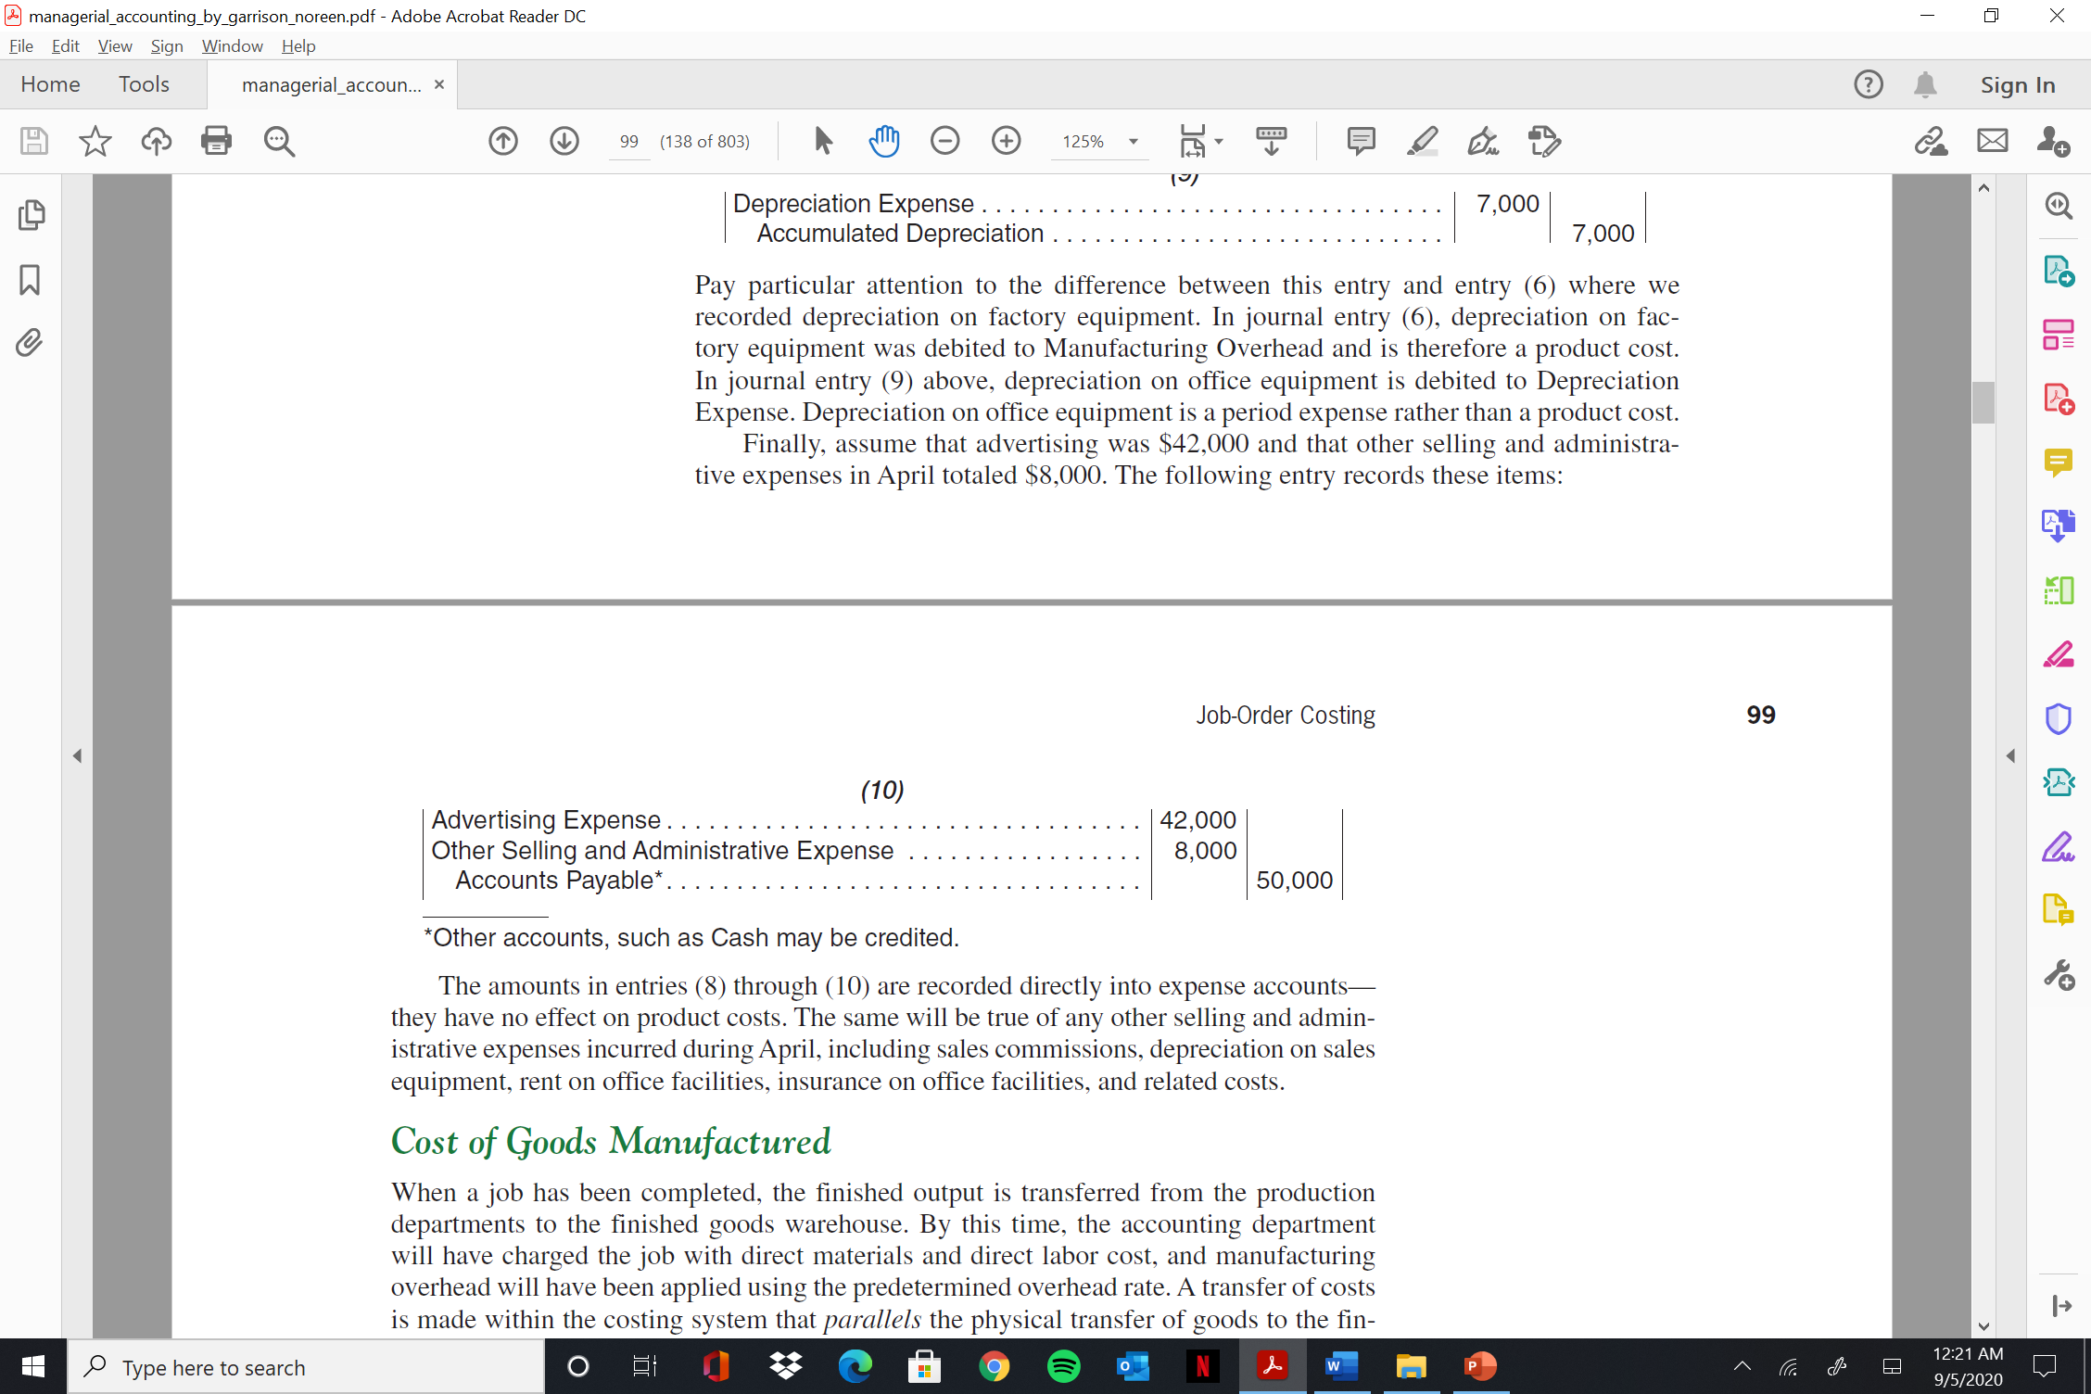
  Job Order Costing
Nonmanufacturing Costs
In addition to manufacturing costs, companies also incur selling and administrative costs. These costs should be treated as period expenses and charged directly to the income statement. Nonmanufacturing costs should not go into the Manufacturing Overhead account.

Slide 22
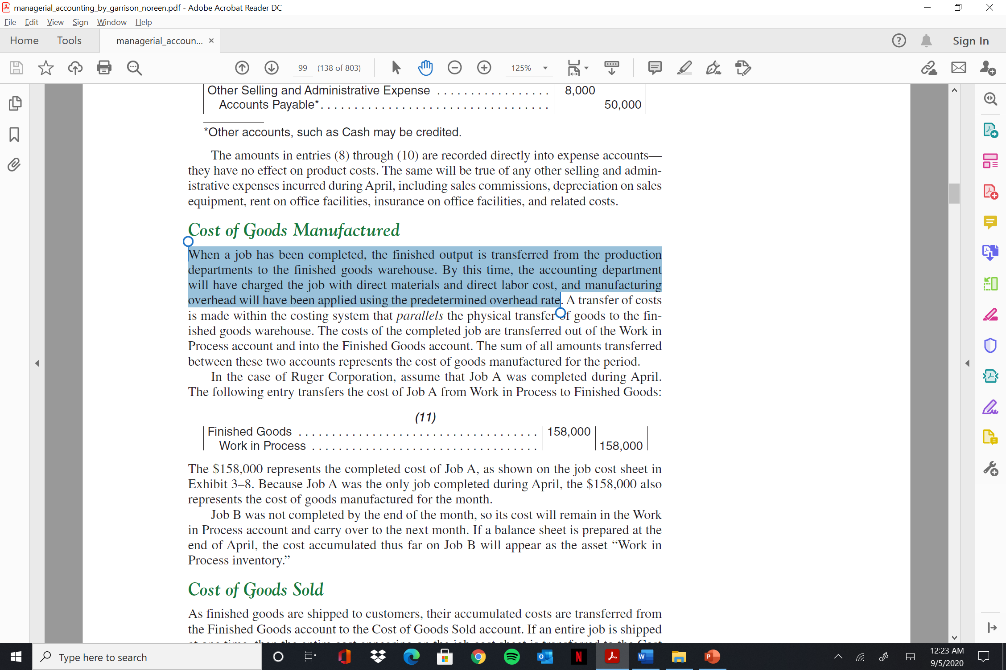
  Job Order Costing
Cost of Goods Manufactured
When a job has been completed, the finished output is transferred from the production departments to the finished goods warehouse. By this time, the accounting department will have charged the job with direct materials and direct labor cost, and manufacturing overhead will have been applied using the predetermined overhead rate.
The $158,000 represents the completed cost of Job A, as shown on the job cost sheet in Exhibit 3–8 . Because Job A was the only job completed during April, the $158,000 also represents the cost of goods manufactured for the month.

Slide 23
  Job Order Costing
Cost of Goods Sold
For Ruger Corporation, we will assume 750 of the 1,000 gold medallions in Job A were shipped to customers by the end of the month for total sales revenue of $225,000. Because 1,000 units were produced and the total cost of the job from the job cost sheet was $158,000, the unit product cost was $158. The following journal entries would record the sale (all sales were on account):
(12)
Accounts Receivable . . . . . . . . . . . . . . . . . . . . . . . . . . . . . . . 225,000
Sales . . . . . . . . . . . . . . . . . . . . . . . . . . . . . . . . . . . . . . . . . 225,000
(13)
Cost of Goods Sold . . . . . . . . . . . . . . . . . . . . . . . . . . . . . . . . 118,500
Finished Goods . . . . . . . . . . . . . . . . . . . . . . . . . . . . . . . . . 118,500
(750 units × $158 per unit = $118,500) . . . . . . . . . . . . . . .

Slide 24
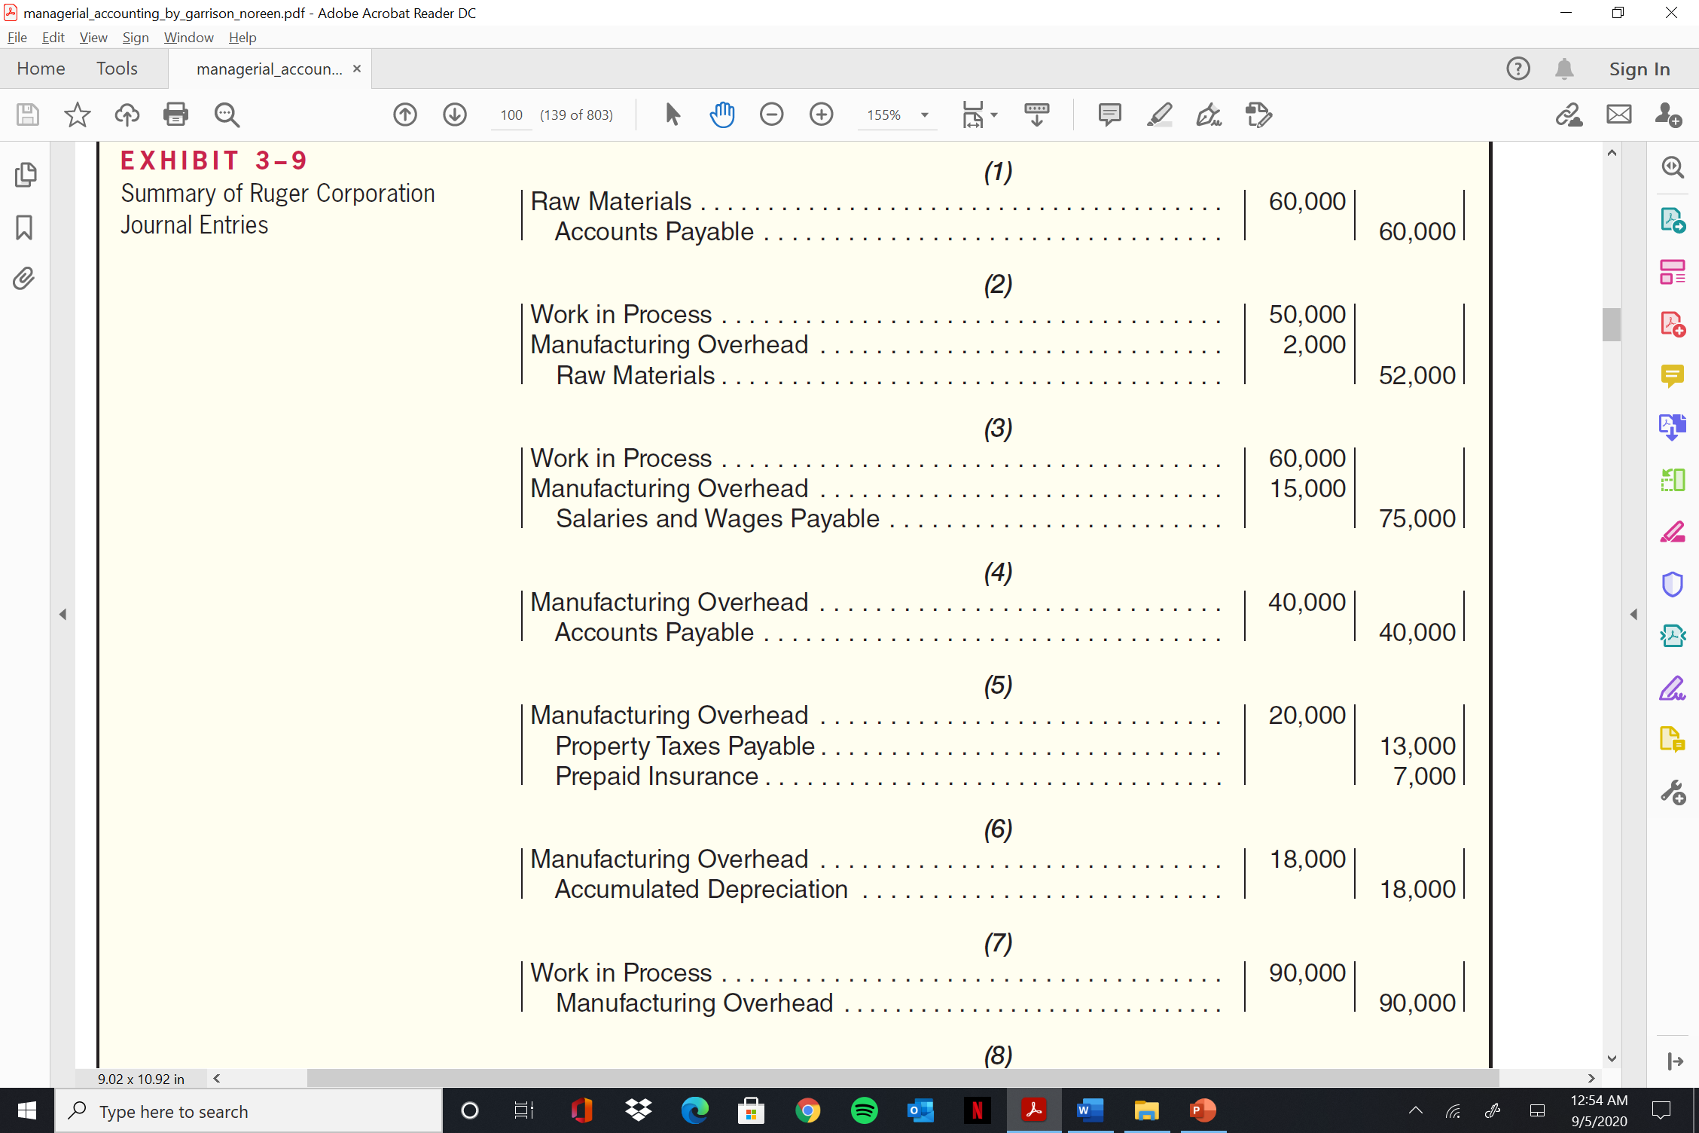
  Summary of all entries

Slide 25
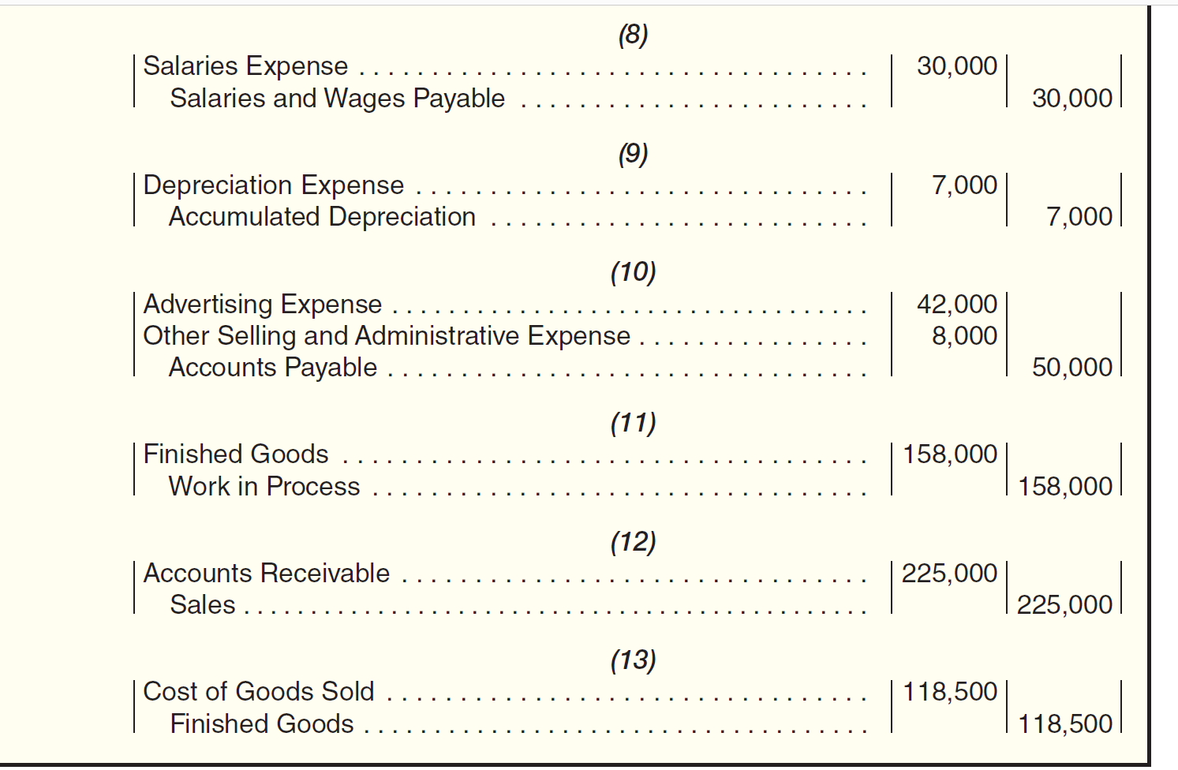
  Summary of all entries

Slide 26
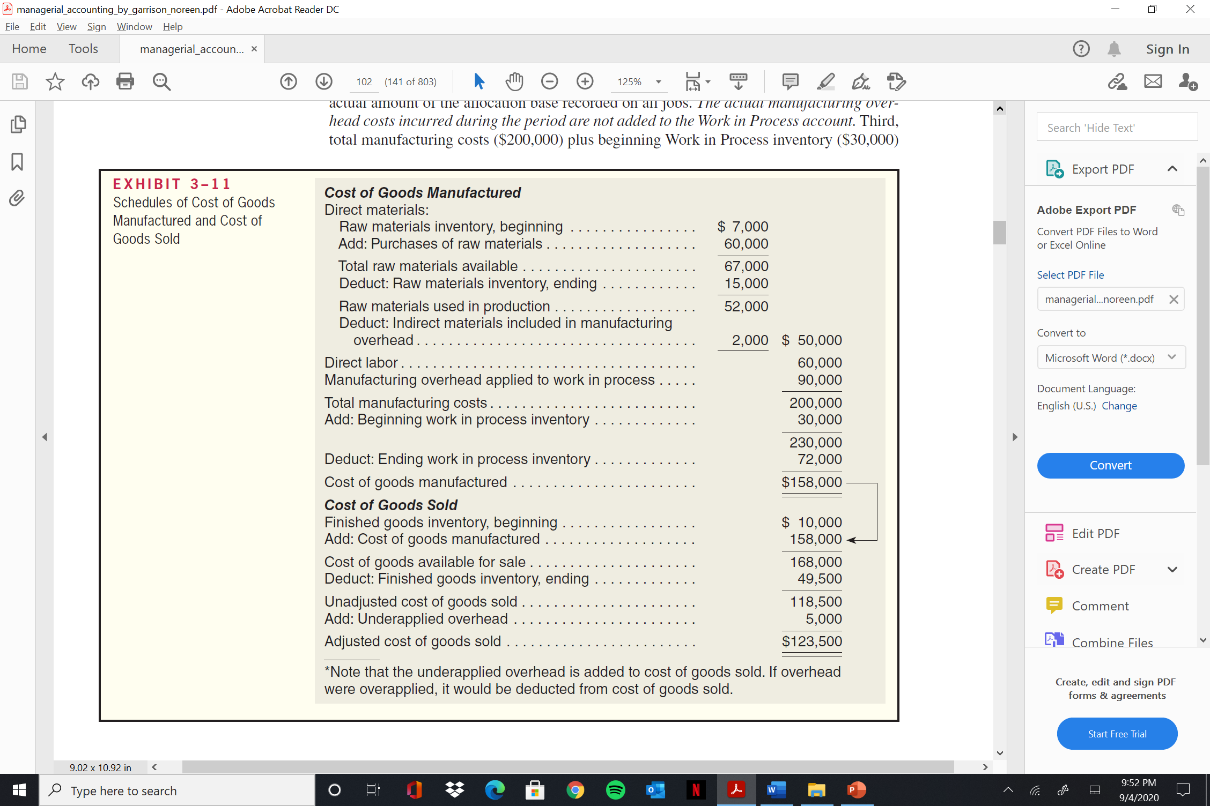
  Cost of goods manufactured

Slide 27
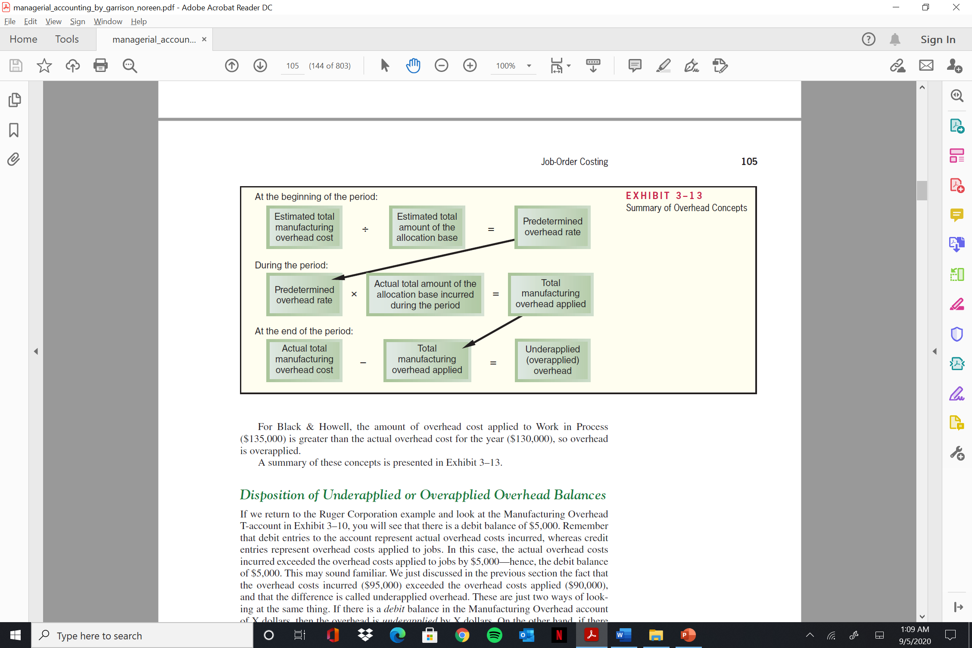
  Job Order Costing
Computing Underapplied and Overapplied Overhead
The difference between the overhead cost applied to Work in Process and the actual overhead costs of a period is called either underapplied or overapplied overhead .
For Ruger Corporation, overhead was underapplied by $5,000 because the applied cost ($90,000) was $5,000 less than the actual cost ($95,000). If the situation had been reversed and the company had applied $95,000 in overhead cost to Work in Process while incurring actual overhead costs of only $90,000, then the overhead would have been overapplied.

Slide 28
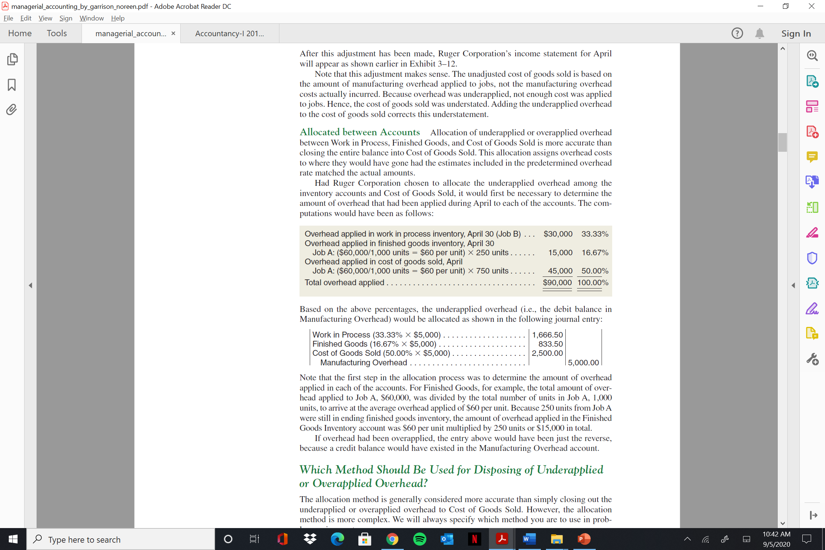
  Job Order Costing
i. Closed Out to Cost of Goods Sold (if difference is insignificant)
Cost of Goods Sold . . . . . . . . . . . . . . . . . . . . . . . . . . . . . . . . . . . . . . 5,000
Manufacturing Overhead . . . . . . . . . . . . . . . . . . . . . . . . . . . . . . . . 5,000
ii. Closed Out to WIP, FG, & COGS (if difference is significant)
Allocation of underapplied or overapplied overhead between Work in Process, Finished Goods, and Cost of Goods Sold is more accurate than closing the entire balance into Cost of Goods Sold.
Had Ruger Corporation chosen to allocate the underapplied overhead among the inventory accounts and Cost of Goods Sold, it would first be necessary to determine the amount of overhead that had been applied during April to each of the accounts. The computations would have been as follows:

Slide 29
  Job Order Costing
Based on the above percentages, the underapplied overhead (i.e., the debit balance in Manufacturing Overhead) would be allocated as shown in the following journal entry:
Work in Process (33.33% × $5,000) . . . . . . . . . . . . . . . . . . . . . . 1,666.50
Finished Goods (16.67% × $5,000) . . . . . . . . . . . . . . . . . . . . . . . 833.50
Cost of Goods Sold (50.00% × $5,000) . . . . . . . . . . . . . . . . . . . . 2,500.00
Manufacturing Overhead . . . . . . . . . . . . . . . . . . . . . . . . . . 5,000.00

Slide 30
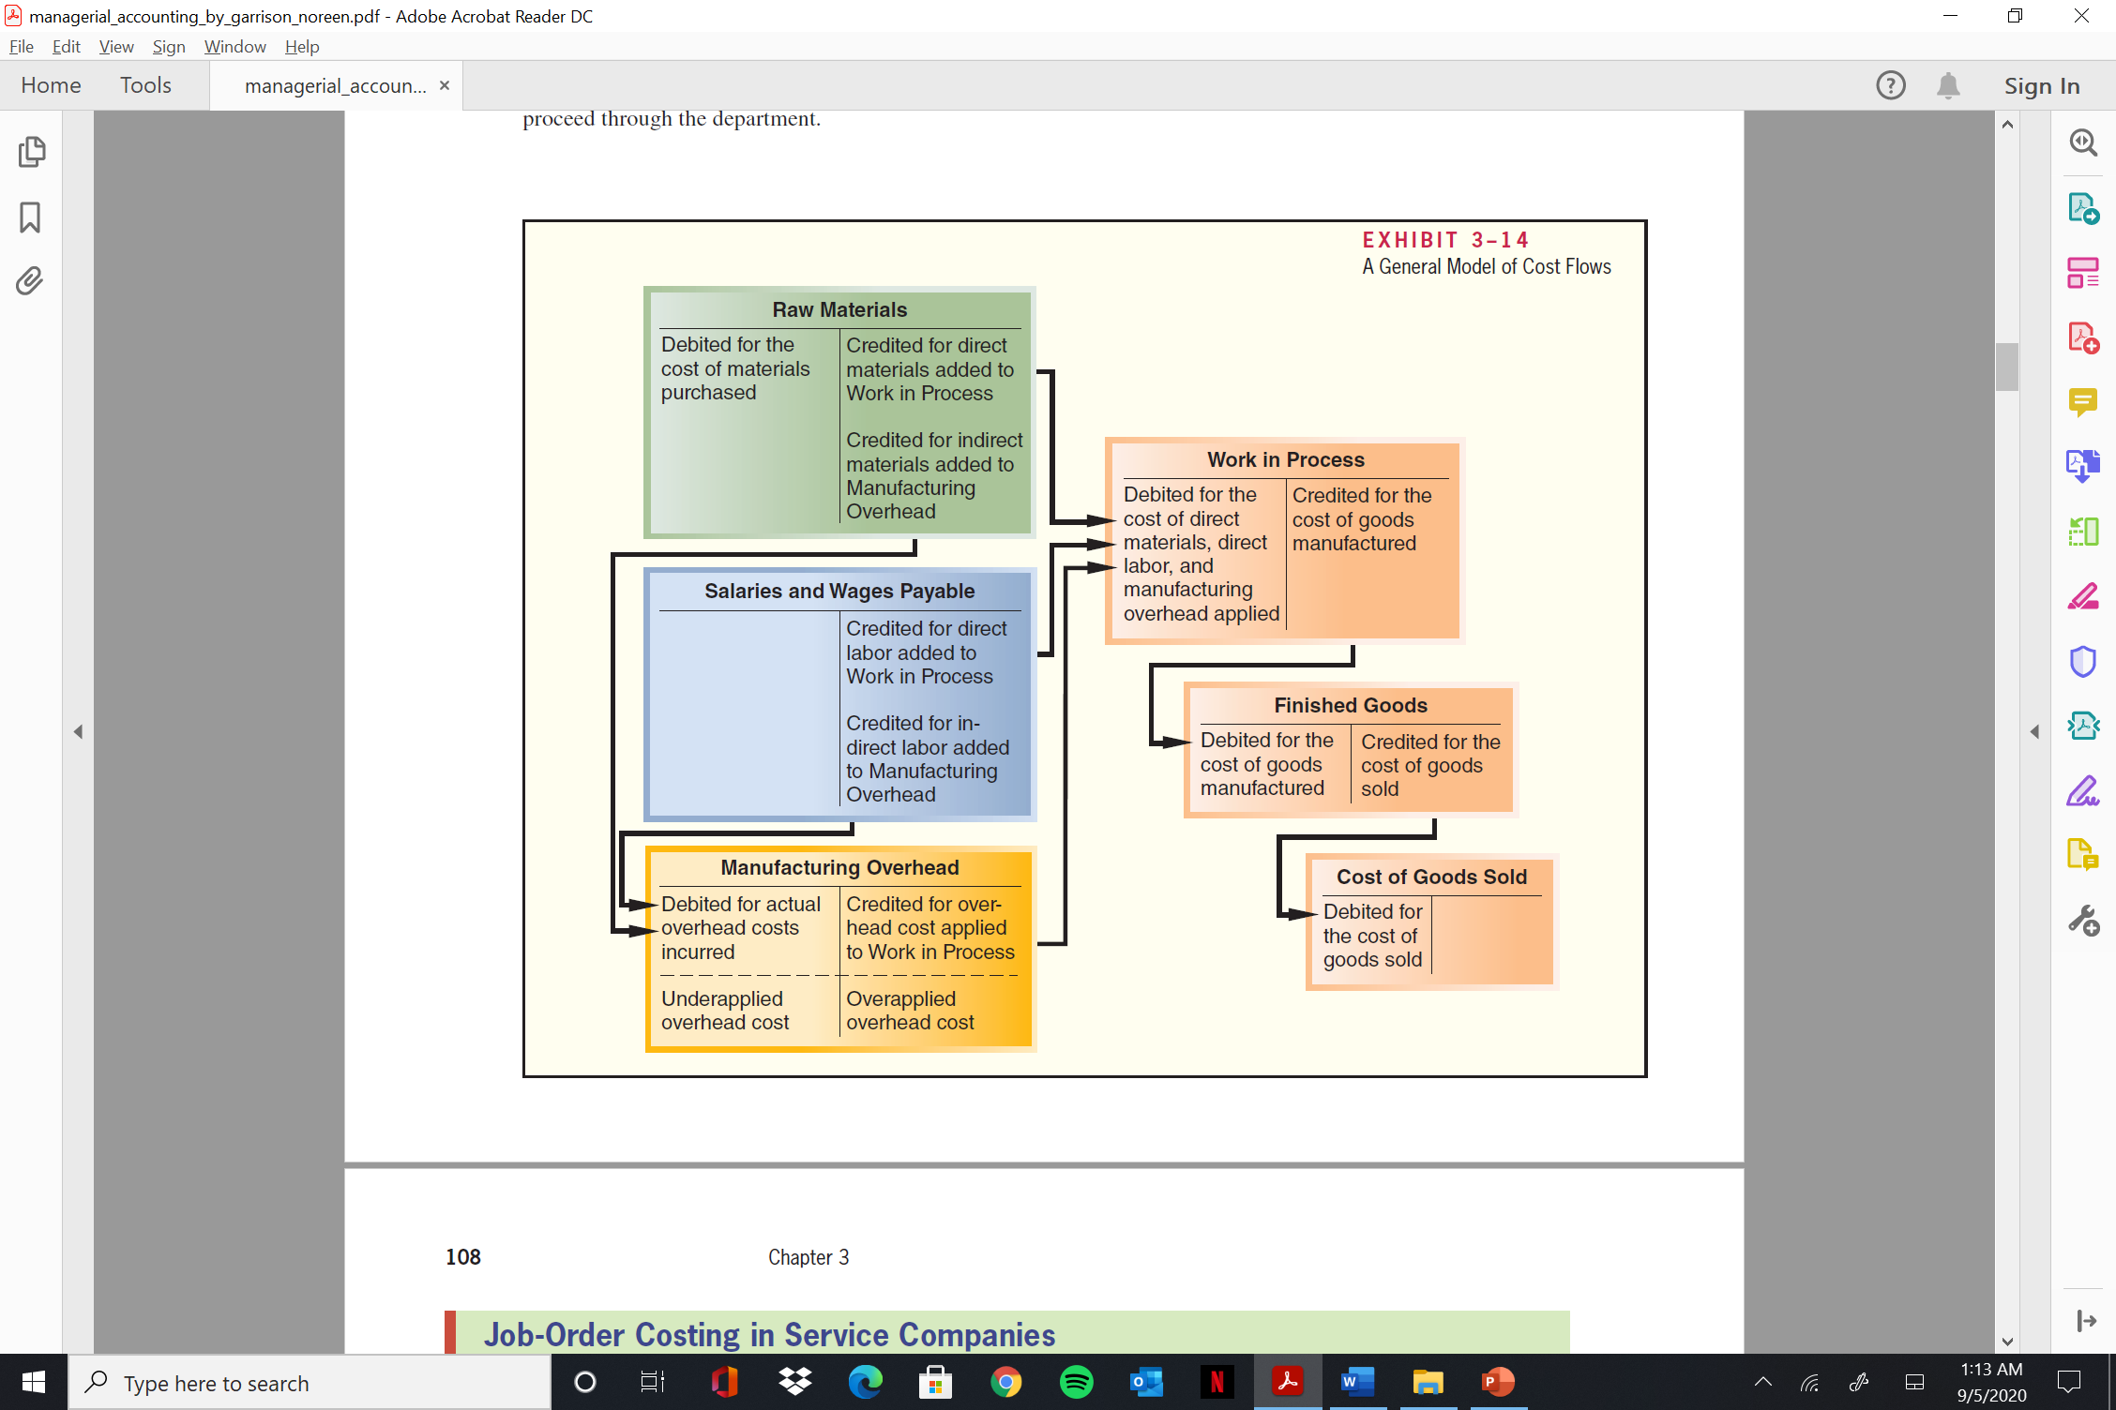
  Job Order Costing

Slide 31
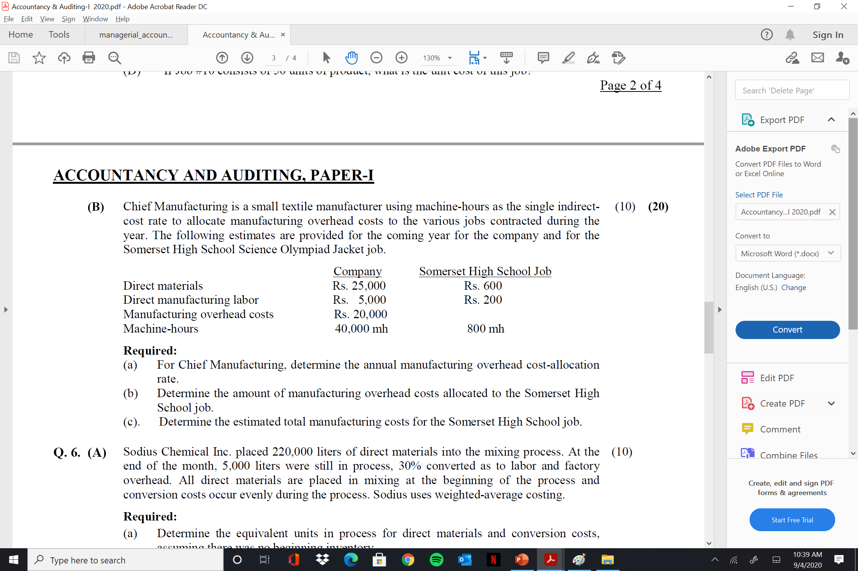
  Job Order Costing – Past Papers

Slide 32
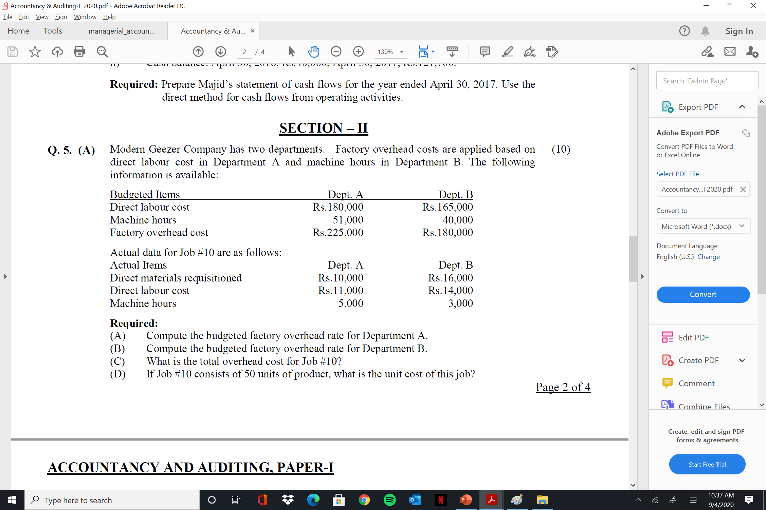
  Job Order Costing – Past Papers

Slide 33
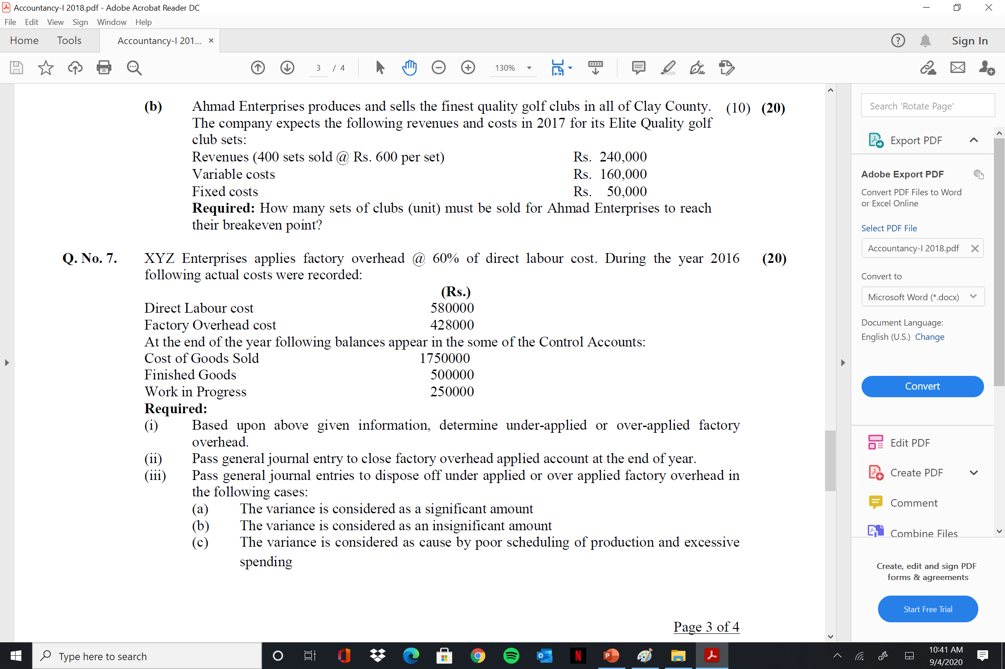
  Job Order Costing – Past Papers

Slide 34

Thank You!
24/7 Accessible Lectures
Q/A from instructors
Notes & Books

