Slide 1
Rational Choice Theory

Slide 2
Introduction
The decision to commit a crime is only made after the offender weighs the potential benefits and consequences of their actions.
If the benefits of crime are greater than its consequences, then commit the crime.
Can we also assume that such common crimes as theft, fraud, and even murder are a function of detailed planning and decision making?
Some criminologists would answer that they believe all criminal behavior, no matter how destructive or seemingly irresponsible, is actually a matter of thought and decision making. As a group, they are referred to as rational choice theorists.

Slide 3
The Development of Rational Choice
During the early Middle Ages (1200–1400), superstition and fear of satanic possession dominated thinking.
It was believed crime was done by people who were evil and sinful.
An estimated 100,000 people were prosecuted throughout Europe for witchcraft during 1500-1700.
These concepts began to change during the Renaissance.
Thomas Hobbes (1588–1678), suggested the existence of a “social contract” between people and the state.
Social Contract: People naturally pursue their own self-interests but are rational enough to realize that selfishness will produce social chaos, so they agree to give up their own selfish interests as long as everyone else does the same thing. Not all agree to the social contract, and therefore the state became empowered with the right to use force to maintain the contract.

Slide 4
The Development of Rational Choice
During the 18th century, Jeremy Bentham embraced the view that people had a rational thought process behind crime.
People choose to act after weighing costs and benefits.
If the punishment (the cost) exceeded the benefits, the person would not commit crime.
Punishment has four objectives:
  To prevent all criminal offenses
  When it cannot prevent a crime, to convince the offender to commit a less serious crime
  To ensure that a criminal uses no more force than is necessary
  To prevent crime as cheaply as possible

Slide 5
The Development of Rational Choice
Italian social philosopher Cesare Beccaria believed people are egotistical and self-centered. Therefore they must be put in line by the fear of punishment.
Beccaria also believed that punishment must be proportional to the seriousness of crime.
Marginal Deterrence: If petty offenses were subject to the same punishment as more serious crimes, offenders would choose the more serious crime because the resulting punishment would be about the same.
Beccaria also suggested that the extremely harsh punishments of the day and routine use of torture were inappropriate and excessive.
The writings of Beccaria and his followers form the core of what today is referred to as classical criminology.
Summary of Classical Criminology:
  People have free will to choose criminal or lawful solutions to meet their needs.
  Criminal solutions can be very attractive because for little effort they hold the promise of a huge payoff.
  “Punishment must fit the crime.”

Slide 6
The Development of Rational Choice
By the middle of the 20th century, the classical perspective was neglected by mainstream criminologists. Criminologists began to focus on internal and external factors—poverty, IQ, education, home life—which were believed to be the true causes of criminality.
Beginning in the mid-1970s, there was renewed interest in the classical approach to crime. Criminologists deduced that people rationally committed crimes and funds should not be wasted on rehabilitation programs.
In contrast, this contemporary version views the decision to commit crime as being shaped by human emotions and thought processes.
It recognizes that other influences have an impact on criminal decision making, including social relationships, individual traits and capabilities, and environmental characteristics.

Slide 7
Concepts of Rational Choice
According to the contemporary rational choice approach, crime occurs when an offender decides to risk breaking the law after considering both personal factors and situational factors.
Why Crime?
  Criminal lifestyle is attractive e.g. teenagers who party
  Sense of control or mastery e.g. selling drugs to buy stylish outfits
  Some people feel alive and competent
  However, as people mature, their thinking extends farther into the future, and risky behavior is a threat to long-range plans.

Slide 8
Concepts of Rational Choice
Choosing Crime
  Reasoning criminals evaluate the risk before committing a crime
  If the rewards are great, the perceived risk small, and the excitement high, the likelihood of committing additional crimes increases.
  Criminals are people who share the same ambitions as conventional citizens but have decided to cut corners and use illegal means to achieve their goals.
Offense and Offender
  Rational choice theorists view crime as both offense-specific and offender-specific.
  Offense-specific means that offenders will react selectively to the characteristics of an individual criminal act e.g. area, get away, target yield, etc.
  Offender-specific means that criminals must decide whether they have the prerequisites to commit a successful criminal act e.g. skills, resources, physical ability, etc.
  Note the distinction made here between crime and criminality. Crime is an event; criminality is a personal trait.

Slide 9
Concepts of Rational Choice
Structuring Criminality
  A number of personal factors condition people to choose crime such as economic opportunity, learning and experience, and knowledge of criminal techniques.
Structuring Crime
  Criminal decision making is not only based on an assessment of personal needs and capabilities, but also on a rational assessment of the criminal event.
  Decisions must be made about the type of crime, the time, place, and target.

Slide 10
Is Crime Rational?
Is Theft Rational?
  Boosters – professional shoplifters or car boosters
  Burglars choose their target (permeable neighborhoods, cash businesses) and plan their moves.
Is Drug Use Rational?
  Research does in fact show that from its onset drug use is controlled by rational decision making.
  Users report that they begin taking drugs when they believe that the benefits of substance abuse outweigh its costs.
  Drug dealers also act rationally; it is a business for them.
Is Violence Rational?
  There are a number of indicators that suggest violence has rational elements.
  Cultural, such as maintaining one’s status and honor.
  Visceral, such as excitement.
  Meting out Informal justice.
  Control, Retribution, Deterrence, Reputation

Slide 11
Eliminating Crime
Situational Crime Prevention:
  Crime prevention can be achieved by reducing the opportunities people have to commit particular crimes.
  Criminal acts will be avoided if:
    potential targets are guarded securely
    the means to commit crime are controlled
    potential offenders are carefully monitored.
General Deterrence Theory:
  Crime rates are influenced and controlled by the threat and/or application of criminal punishment. If people fear being apprehended and punished, they will not risk breaking the law.
  Not only does the actual chance of punishment influence criminality, so too does the perception of punishment.
  The faster punishment is applied and the more closely it is linked to the crime, the more likely it will serve as a deterrent.

Slide 12
Eliminating Crime
Specific Deterrence Theory
  Theory states that after experiencing criminal sanctions that are swift, sure, and powerful, known criminals will never dare repeat their criminal acts.
  While general deterrence relies on the perception of future punishments, specific deterrence relies on its application.
  According to the theory of specific deterrence, the harsher the punishment, the less likely the chances of recidivism.
Incapacitation
  If more criminals are sent to prison, the crime rate should go down – the criminals should be incapacitated.
  Does it work? One in every 100 adults is behind bars in USA. The crime rate has gone down.
  However, incapacitation leads to hardened criminals and burden on justice system financially.

Slide 13
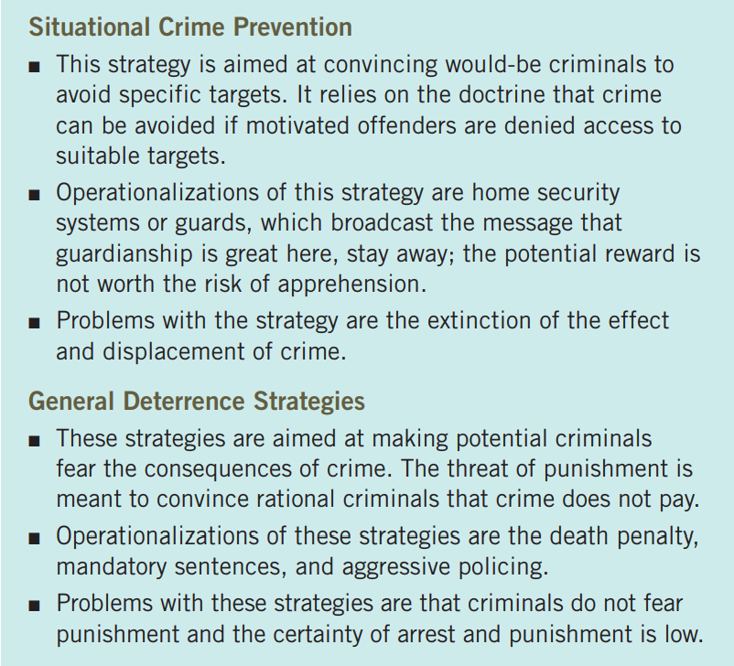
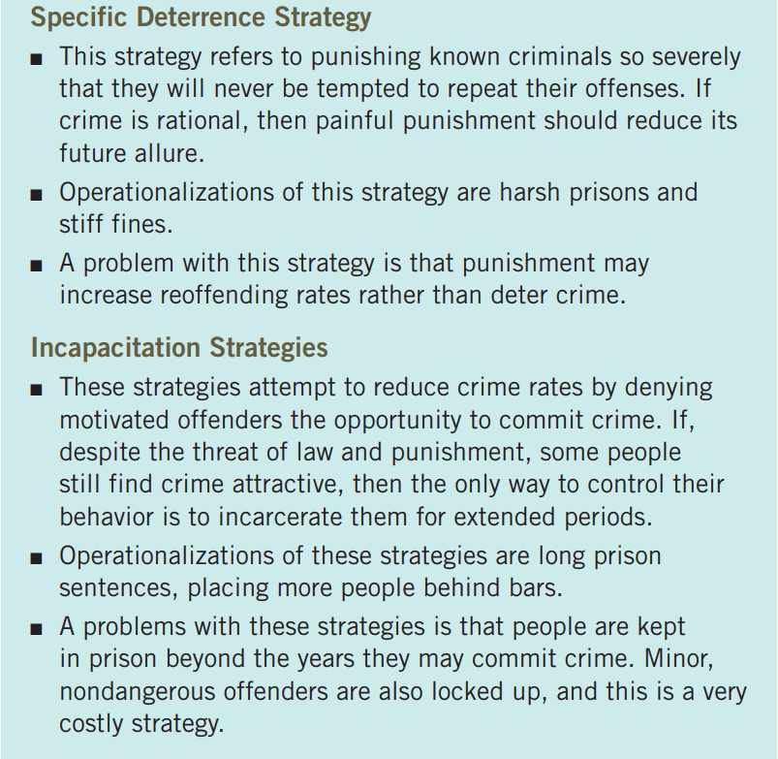
Eliminating Crime - Summary

Slide 14
PUBLIC POLICY IMPLICATIONS
Police patrol → deterrence
Prison life displayed to public → deterrence
Punishments → deterrence
Despite the ongoing debate about its deterrent effect, some advocates argue that the death penalty can effectively restrict criminality; at least it ensures that convicted criminals never again get the opportunity to kill.
The concept of criminal choice has also prompted the creation of justice policies referred to as just desert - receive what one deserves, especially appropriate punishment. If you give punishments to create deterrence, then you can just hang anyone for the simplest of crimes.

Slide 15
Examples of Rational Choice Criminals
Albert Robles served terms as mayor, councilman, and deputy city manager of South Gate, California. He transferred public funds ($2.4 million) to a shell corporation he had set up. He was investigated by the FBI.
“Pump and dump” fax example of Michael Pickens suggests he planned and had knowledge of how to manipulate stock market.

Slide 16
Trait Theories

Slide 17
Foundations of Trait Theory
Since the 19th century, criminologists have suggested that biological and psychological traits have the power to influence social behavior.
During the late 19th century, scientific method (positivism) was beginning to take hold in Europe.
If the scientific method could be applied to the study of the natural world, then why not use it to study human behavior?
People are neither born “good” nor “bad,” and are neither “saints” nor “sinners.” They are a product of their social and psychological traits, influenced by their upbringing and environment.

Slide 18
Foundations of Trait Theory
Biological Positivism
  Phrenologists, such as Franz Joseph Gall (1758–1828), studied the shape of the skull and bumps on the head to determine whether these physical attributes were linked to criminal behavior. It is considered a pseudo-science now.
  When Sigmund Freud’s (1856–1939) work on the unconscious gained traction, the psychological basis of behavior was forever established.
Cesare Lombroso
  An Italian physician who was trying to scientifically determine whether criminals were physically different from common people.
  He believed criminals had primitive physical traits which he called atavistic anomalies.
  He attracted a circle of followers who expanded on his vision of biological determinism and helped stimulate interest in what is referred to as criminal anthropology.

Slide 19
Foundations of Trait Theory
William Sheldon’s Somatotype School
  Criminals manifest three distinct physiques that make them susceptible to particular types of antisocial behavior.
  Mesomorphs have well-developed muscles and an athletic appearance. They are active, aggressive, sometimes violent, and the most likely to become criminals.
  Endomorphs have heavy builds and are slow moving. They are known for lethargic behavior, rendering them unlikely to commit violent crime and more willing to engage in less strenuous criminal activities such as fencing stolen property.
  Ectomorphs are tall, thin, and less social and more intellectual than the other types. These types are the least likely to commit crime.

Slide 20
Foundations of Trait Theory
The work of Lombroso and his contemporaries is regarded today as a historical curiosity, not scientific fact. Strict biological determinism is no longer taken seriously.
Even if most criminals shared some biological traits, they might be products not of heredity but of some environmental condition, such as poor nutrition or health care.
Today, criminologists believe that environmental conditions interact with human traits and conditions to influence behavior. Hence, the term biosocial theory.
Contemporary theorists believe that biological factors affect behavior which in turns affects how a person interacts with society – this view is called trait theory.
Trait theorists focus on basic human behavior and drives—attachment, aggression, violence, impulsivity—that are linked to antisocial behavior patterns.
Contemporary trait theories can be divided into two major subdivisions:
  Biosocial
  Psychological Functioning

Slide 21
Biosocial Theories
Biological Factors + Social Factors → CRIME
The biosocial theories have five divisions:
  Biochemical Theory
  Neurophysiological Theory
  Arousal Theory
  Genetics Theory
  Evolutionary Theory

Slide 22
Biosocial Theories
Biochemical Factors
  Exposure to harmful chemicals and poor diet at birth and beyond may affect people throughout their life course. They result in violent, anti-social and aggressive behavior. Some are listed below.
  Smoking and Drinking
  Over- or-undersupply of certain chemicals and minerals—including sodium, mercury potassium, calcium, amino acids, monoamines, and peptides—can lead to depression, mania, cognitive problems, memory loss, and abnormal sexual activity.
  Food intake
  Sugar intake (but mixed opinions on it)
  Glucose Metabolism/Hypoglycemia
  Hormones (male sex hormones – androgens mainly testosterone lead to aggression)
  Premenstrual Syndrome (PMS)
  Allergies (cerebral and neuro allergies)
  Environment Contaminants
  Lead Ingestion (WWII lead guns → high crime rate, WWII ended → crime rate dropped)

Slide 23
Biosocial Theories
Neurophysiological Conditions
  Some researchers focus their attention on neurophysiology, the study of brain activity. They believe neurological and physical abnormalities control behavior throughout the life span.
  3 Ways in which this order may take place: direct, indirect, interactive (brain + society)
  Neurological impairment can be measured by electroencephalograph (EEG), which records the electrical impulses given off by the brain. Criminals tend to have abnormal EEG readings.
  Neurophysiological Problems:
    Minimal brain dysfunction (MBD) is related to an abnormality in cerebral structure leading to crime.
    Learning Disabilities
    Attention Deficit Hyperactivity Disorder (ADHD)
    Tumors, Lesions, Injury, and Disease
    Brain Chemistry

Slide 24
Biosocial Theories
Arousal Theory
  According to arousal theory, for a variety of genetic and environmental reasons, some people’s brains function differently in response to environmental stimuli.
  The factors that determine a person’s level of arousal are not fully determined, but suspected sources include:
    Brain chemistry - Some people have brains with many more nerve cells with receptor sites.
    Heart Rate - people with low heartbeat rates are more likely to commit crime because they seek stimulation
    Autonomic Nervous System - provocations that some people might merely shrug off are viewed as highly confrontational by others.

Slide 25
Biosocial Theories
Genetics Theory
  What role does genetics plays in shaping human behavior and whether an inherited trait passed down from one generation to the next can lead to crime?
  A number of studies have found that parental criminality and deviance do, in fact, have a powerful influence on delinquent behavior especially bullying.
  Research does show that if one sibling engages in antisocial behavior, so do his/her brothers and sisters.
  Biosocial theorists have compared the behavior of same sex twins and again found concordance in their behavior patterns.
  Twin studies also have their detractors. Some opponents suggest that available evidence provides little conclusive proof that crime is genetically predetermined.
  The genes–crime relationship is controversial because it implies that the propensity to commit crime is present at birth and cannot be altered. It raises moral dilemmas: if someone’s parent is a criminal, should we lock up the children as a precautionary measure?

Slide 26
Biosocial Theories
Evolutionary Theory
  Some criminologists believe the human traits that produce violence and aggression are produced through the long process of human evolution.
  According to this evolutionary view, the competition for scarce resources has influenced and shaped the human species.
  Evolutionary concepts have been linked to gender-based differences in the crime rate. Males are aggressive. They mate a lot more than woman. Hence, aggression part of society.
  High rates of spouse abuse in modern society may be a function of aggressive men seeking to control and possess mates.

Slide 27
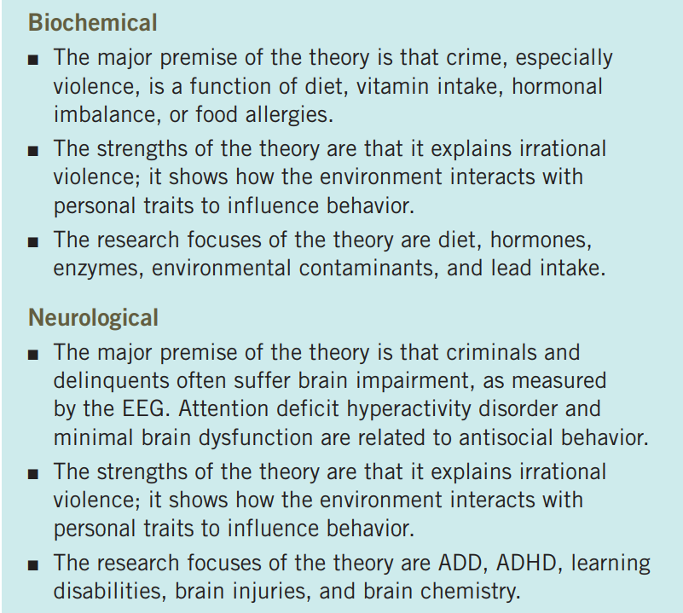
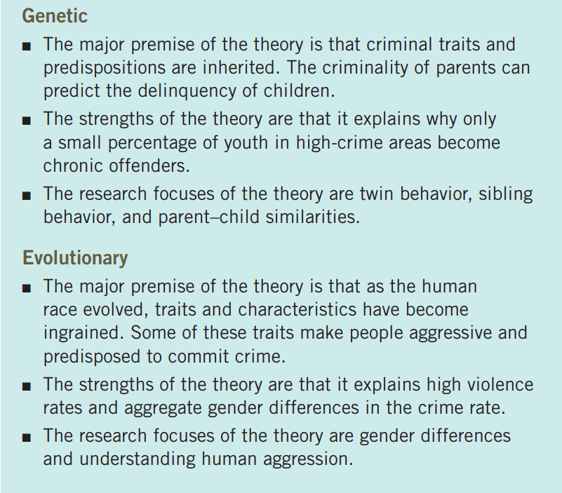
Biosocial Theories - Summary

Slide 28
Psychological Trait Theories
The second branch of trait theories focuses on the psychological aspects of crime, including the associations among intelligence, personality, learning, and criminal behavior.
Charles Goring in the English Convict found little commonalities of physical characteristics of criminals but he did see a pattern of similar psychological characteristics – he called it defective intelligence.
There are many psychological trait theories:
  Psychodynamic Theory
  Attachment Theory
  Mental Disorders and Crime
  Behavioral Theory
  Cognitive Theory

Slide 29
Psychological Trait Theories
Psychodynamic Theory
  Psychodynamic (or psychoanalytic) psychology was founded by Viennese psychiatrist Sigmund Freud and has since remained popular in the field of psychology.
  Contemporary psychodynamic theory places greater emphasis on conscious experience and its interaction with the unconscious, in addition to the role that social factors play in development.
  Elements of Psychodynamic Theory:
    Id (Pleasure Principle) - Unconscious biological drives; requires instant gratification
    Ego (Reality Principle) - Helps the personality refine the demands of the id; helps person adapt to conventions
    Superego (The conscience) - The moral aspect of the personality; superego is divided into two parts: conscience and ego ideal. Conscience tells what is right and wrong. It forces the ego to control the id and directs the individual into morally acceptable and responsible behaviors, which may not be pleasurable.

Slide 30
Psychological Trait Theories
Psychodynamic Theory (continued)
  Stages of Human Development
    Oral Stage - the first year of life, a child attains pleasure by sucking and biting
    Anal Stage - the focus of sexual attention is on the elimination of bodily wastes
    Phallic Stage - occurs during the third year, when children focus their attention on their genitals. Males begin to have sexual feelings for their mothers (the Oedipus complex) and girls for their fathers (the Electra complex).
  If conflicts are encountered during any of the stages of development, a person can become fixated at that point e.g. an infant who does not receive enough oral gratification during the first year of life is likely as an adult to engage in such oral behavior as smoking, drinking, or drug abuse.
  Psychologists have long linked criminality to abnormal mental states:
    Inferiority Complex
    Identity Crisis
    Latent delinquency (certain people have a personal characteristic that is responsible for their need to commit crime)
    Bipolar Disorder

Slide 31
Psychological Trait Theories
Attachment Theory
  Emotional bonds to another person has important lasting psychological implications that follow people across the life span.
  According to this view, failing to develop proper attachment may cause people to fall prey to a number of psychological disorders.
  Criminologists have linked people having detachment problems with a variety of antisocial behaviors, including sexual assault and child abuse.
Behavioral Theory
  Behavior theorists are concerned with the actual behaviors people engage in during the course of their daily lives.
  The major premise of behavior theory is that people alter their behavior according to the reactions it receives from others.
  Behavior is supported by rewards and extinguished by negative reactions or punishments.
  Social Learning is the branch of behavior theory most relevant to criminology.
  People learn to act aggressively when, as children, they model their behavior after the violent acts of adults.
  Behavior is learned by: family, environment and mass media.

Slide 32
Psychological Trait Theories
Cognitive Theory
  Psychologists with a cognitive perspective focus on mental processes and how people perceive and mentally represent the world around them and solve problems.
  Today, there are several subdisciplines within the cognitive area:
    The moral development branch is concerned with the way people morally represent and reason about the world.
    Humanistic psychology stresses self-awareness and “getting in touch with feelings.”
    The information processing branch focuses on the way people process, store, encode, retrieve, and manipulate information to make decisions and solve problems.

Slide 33
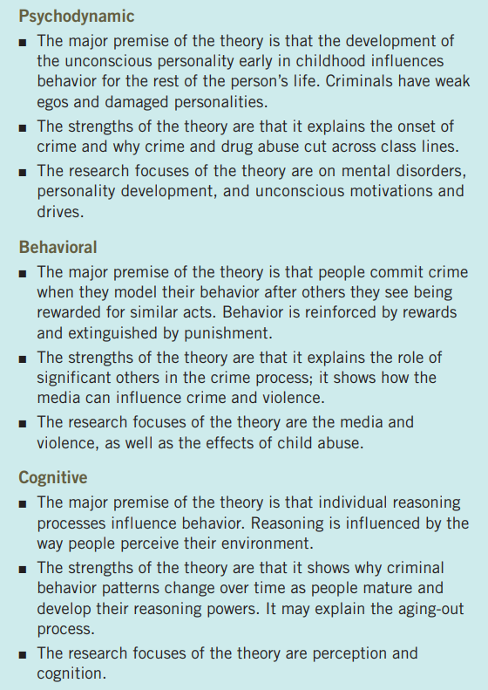
Psychological Trait Theories - Summary

Slide 34
Personality, Intelligence and Crime
Personality characteristics that may lead to criminality:
  extroversion
  feeling unappreciated
  ambivalence
  distrust of authority
  impulsiveness
  poor personal skills
  narcissism
The terms psychopath and sociopath are commonly used to describe people who have an antisocial personality. People with these traits have been involved in some of the nation’s most notorious crimes.
  Sociopath → abnormal personality due to society
  Psychopath → abnormal personality due to genetic defect
Intelligence and Crime
  Nature theory argues that intelligence is largely determined genetically. Low IQ people have a higher chance of committing crimes.
  Nurture theory states that intelligence must be viewed as partly biological but primarily sociological. Low IQ is a result of bad social conditions and it leads to crime.

Slide 35
Examples of Trait Theories Criminals
In 2007, 23-year-old Seung-Hui Cho took the lives of 32 people—27 students and 5 professors—at Virginia Tech before taking his own life. He was described as “anti-social” and a “loner”. He had been involuntarily institutionalized in a mental health facility.
There have been numerous anecdotal cases of violence linked to TV and films. In a famous incident, John Hinckley shot President Ronald Reagan due to his obsession with actress Jodie Foster, which developed after he watched her play a prostitute in the violent film Taxi Driver. Hinckley viewed the film at least 15 times.
Robert Chambers killed Jennifer Levin in New York and claimed it was an accident and she was trying to rape her. Later, it was found through a videotape that he was a socio-path/psycho-path. He served and and is currently serving 15+19 years.

Slide 36
Social Theories

Slide 37
Introduction
Social Structure Theories
  Social Disorganization Theory
  Strain Theories
  Cultural Deviance Theories
Social Process Theories
  Social Learning Theory
  Social Control Theory
  Social Reaction Theory/Labelling Theory

Slide 38
Social Structure Theories
Social Theories

Slide 39
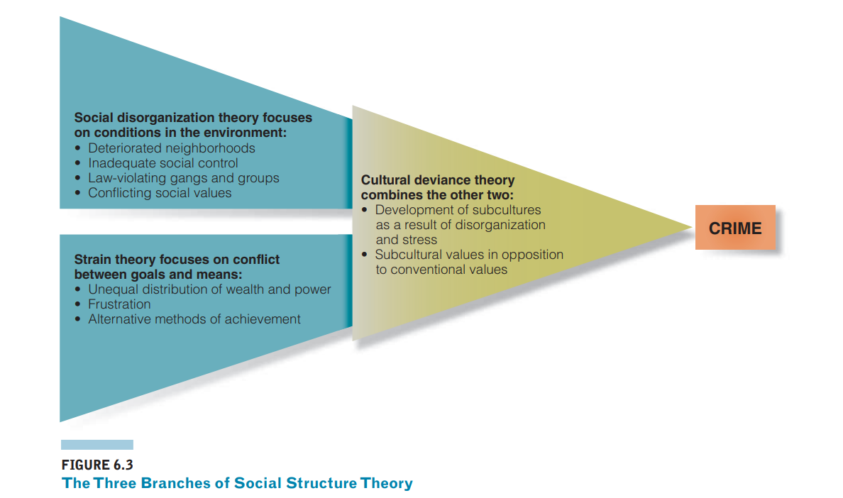
Social Structure Theories
There are three independent yet overlapping branches within the social structure perspective — social disorganization, strain theory, and cultural deviance theory.

Slide 40
Social Structure Theories
Social Disorganization Theory
  Social disorganization theory focuses on the conditions within the urban environment that affect crime rates.
  A disorganized area is one in which institutions of social control—such as the family, commercial establishments, and schools—have broken down and can no longer carry out their expected or stated functions.
  Residents in these crime-ridden neighborhoods become disenfranchised leading to destabilization.
  Because social institutions are frayed or absent, law-violating youth groups and gangs form and are free to recruit neighborhood youth.
  Social disorganization theory was first popularized by the work of two Chicago sociologists, Clifford R. Shaw and Henry D. McKay, who linked life in disorganized, transitional urban areas to neighborhood crime rates.

Slide 41
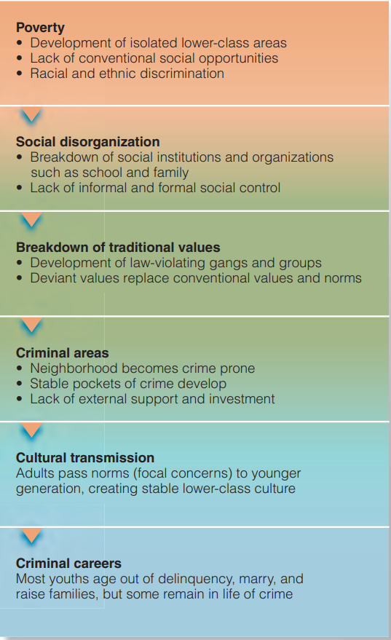
Social Structure Theories
Social Disorganization Theory (continued)
  Conclusions:
    Crime rates are sensitive to the destructive social forces operating in lower-class urban neighborhoods.
    Environmental factors, rather than individual differences, are the root cause of crime. Personal abnormality or inferiority has little to do with crime rates.
    Crime is a constant fixture in poverty areas regardless of racial or ethnic makeup.
    Neighborhood disintegration and the corresponding erosion of social control are the primary causes of criminal behavior; community values, norms, and cohesiveness affect individual behavior choices.

Slide 42
Social Structure Theories
Strain Theories
  When people can’t achieve their goals, or have the standard of living they desire, they begin to feel frustrated and angry – a condition that is referred to as strain.
  Strain is related to criminal motivation. People who feel economically and socially humiliated may perceive the right to humiliate others in return.
  According to the strain view, sharp divisions between the rich and poor create an atmosphere of envy and mistrust that may lead to violence and aggression.
  Strain theories come in two distinct formulations:
    Structural Strain: economic and social sources of strain shape collective human behavior.
    Individual Strain: individual life experiences cause some people to suffer pain and misery, feelings that are then translated into antisocial behaviors.

Slide 43
Social Structure Theories
Strain Theories (continued)
  The roots of strain theories can be traced to Émile Durkheim’s notion of anomie; rules of behavior have broken down during periods of rapid social change or social crisis such as war or famine.
  Sociologist Robert Merton used a modified version of the concept of anomie.
  He found that two elements of culture interact to produce potentially anomic conditions:
    culturally defined goals.
    socially approved means for obtaining them.
  Society wants us to be successful but in a certain way which is permissible e.g. hard work, education, job (9-5), etc.
  When people can’t get access to these ways, they experience “strain”. This strain produces anomie among them and consequently, they look for criminal or delinquent solutions to the problem of attaining goals.

Slide 44
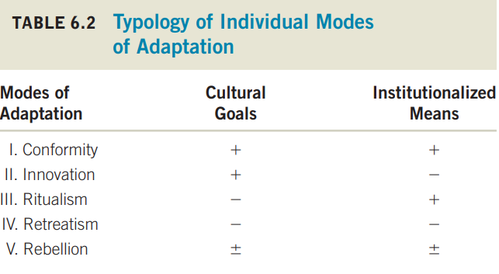
Social Structure Theories
Strain Theories (continued)
  Merton argued that there are many ways in people adapt to these two conditions (goals, and procedure to achieve those goals).
    Conformity – people who agree with goals and achieve them through socially approved means e.g. educated person with job.
    Innovation – people who agree with goals but find new ways (sometimes disapproved ways) to achieve them e.g. crime.
    Ritualism – people who have the socially approved means but don’t care about the goals e.g. bureaucrats.
    Retreatism – people who don’t care about society or the goals e.g. drug addicts.
    Rebellion – people who want to substitute an alternative set of goals and means for conventional ones e.g. human right workers, etc.
  Merton’s view of anomie has been one of the most enduring and influential sociological theories of criminality.
  Critique: Merton does not explain why people choose to commit certain types of crime. For example, why does one anomic person become a mugger and another deal drugs?

Slide 45
Social Structure Theories
Strain Theories (continued)
  There are two levels of strain theory; macro-level and micro-level.
  Macro Level Theory
    Antisocial behavior occurs due to cultural and institutional influences in U.S. society, a model they refer to as institutional anomie theory.
    People chase after economic success; everything else (family, church, school) comes later.
    Concept of “American Dream”
    At the institutional level, the dominance of economic concerns weakens the informal social control exerted by the family, church, and school. These institutions have lost their ability to regulate behavior and have instead become a conduit for promoting material success.
  Micro Level Theory (General Strain Theory)
    Focus is on individual influences of strain.
    Individuals commit crime when they face:
      Failure in achieving goals
      Unreasonable expectations and achievements
      Removal of positively valued stimuli e.g. death of loved one.
      Presentation of negative stimuli e.g. being abused as a child

Slide 46
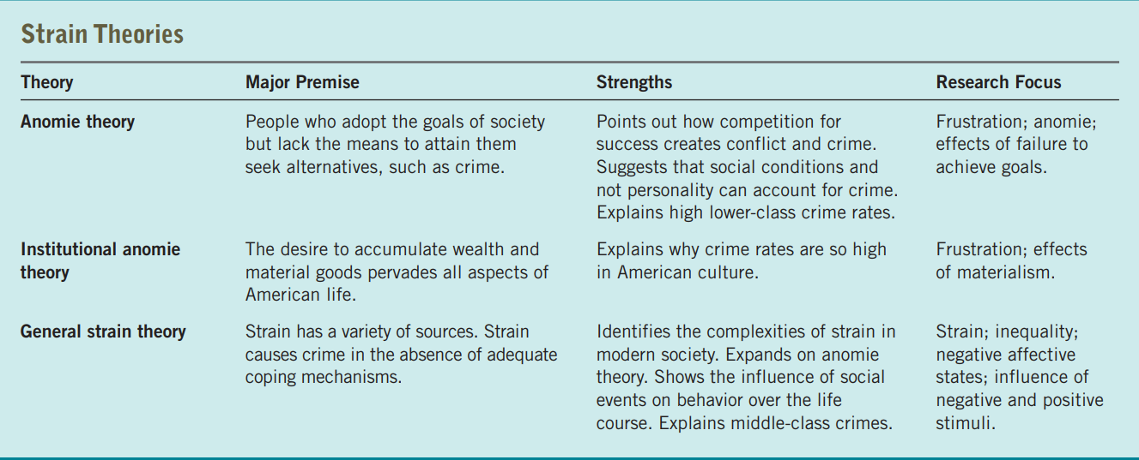
Social Structure Theories
Strain Theories (continued)

Slide 47
Social Structure Theories
Cultural Deviance Theories
  The third branch of social structure theory combines the effects of social disorganization and strain to explain how people living in deteriorated neighborhoods react to social isolation and economic deprivation.
  Focus in on lower-class people; how their actions and subcultures (instant gratification, etc.) lead to crime.
  When the police are trying to solve a gang-related killing, neighbors may find that their loyalty to the gang boy and his family outweighs their desire to create a more stable crime-free community by giving information to the police.
  Law is created by the dominant culture which may clash (culture conflict) with subcultures.

Slide 48
Social Structure Theories
Cultural Deviance Theories (continued)
  Millers Focal Concern Theory
    In lower class cultures, people have focal concerns which may lead to criminal behavior. These focal concerns are:
      Getting into trouble
      Toughness
      Smartness – “street smart”
      Excitement – gambling, drinking, etc.
      Fate – if we die, we die.
      Autonomy – local gangs have more respect than police.
  Cohen’s Theory of Delinquent Gangs
    According to Cohen, the development of the delinquent subculture is a consequence of bad socialization practices found in the ghetto or inner-city environment.
    He suggests that lower-class parents are incapable of teaching children the necessary techniques for entering the dominant middle-class culture.
    As they can’t join middle-class culture, they either become “corner boy (menial job)” or “delinquent boy (gangs)”.
    Cohen makes it clear that social forces and not individual traits promote and sustain a delinquent career.

Slide 49
Social Structure Theories
Cultural Deviance Theories (continued)
  Cloward and Ohlin’s Theory of Opportunity
    Richard Cloward and Lloyd Ohlin combined strain and social disorganization principles into a portrayal of a gang-sustaining criminal subculture.
    Cloward and Ohlin agreed with Cohen and found that independent delinquent subcultures exist within society.
    Concept of differential opportunity states that people in all strata of society share the same success goals but that those in the lower class have limited means of achieving them.
    People who perceive themselves as failures within conventional society will seek alternative or innovative ways to gain success:
      Criminal gangs – youths become part of established criminal enterprises/organized crime
      Conflict gangs – no organization, gangs fight each other as rivals for territory
      Retreatist gangs – when both legal and illegal means of achieving goals fail, these people just want to retreat, do drugs and get high. They become pimps, dealers and do petty crimes.

Slide 50
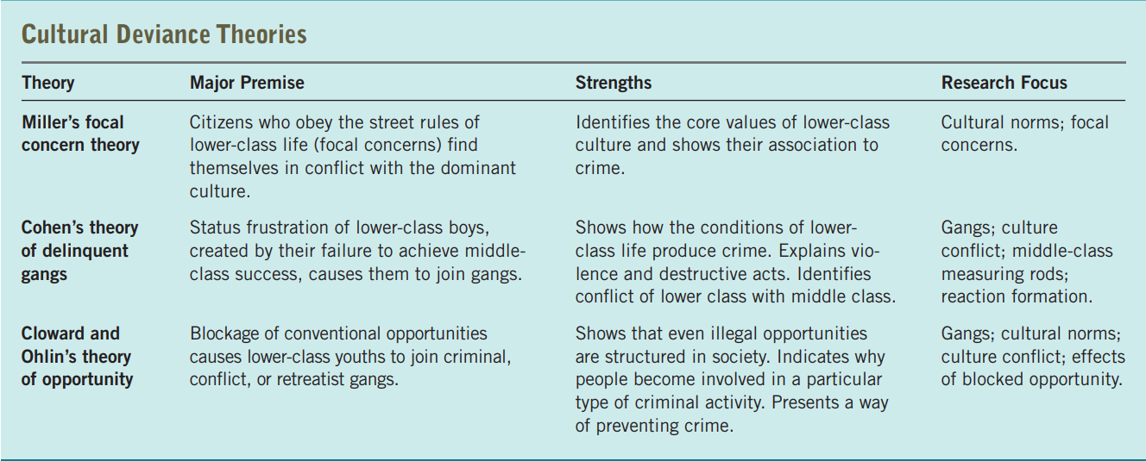
Social Structure Theories
Cultural Deviance Theories (continued)

Slide 51
Social Process Theories
Social Theories

Slide 52
Social Process Theories
What society “perceives” to be criminal. A crime today, might not be a crime yesterday and vice versa.
Socialization and Crime
  Social structures alone don’t lead to criminal activity. After all, many people living in the most deteriorated areas never commit criminal offenses. So what gives?
  The key to understanding crime can be found in human socialization—the interactions people have with various organizations, institutions, and processes of society.
  If socialization good → no crime. If socialization bad → CRIME.
  This view of crime is referred to as social process theory.
  Major determinants are:
    Family - divorce, family deviance, parental efficacy, child maltreatment, etc.
    Educational Experience - dropping out, bad institute, etc.
    Peer Relations
    Religion – not caring for religion, etc.
Social process theorists believe it is socialization, not the social structure, that determines life chances. The more social problems encountered during the socialization process, the greater the likelihood that youths will encounter difficulties and obstacles as they mature, such as being unemployed or becoming a teenage mother.

Slide 53
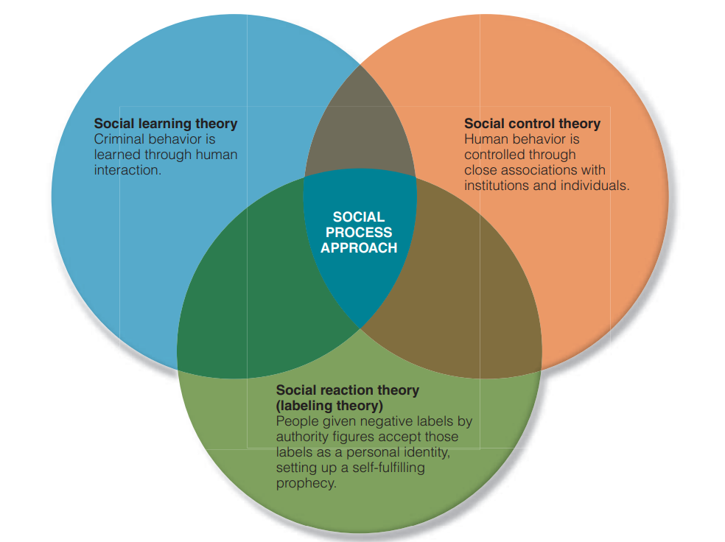
Social Process Theories
The social process approach has several independent branches
  Social learning theory suggests that people learn the techniques and attitudes of crime from close and intimate relationships with criminal peers; crime is a learned behavior.
  Social control theory maintains that everyone has the potential to become a criminal, but that most people are controlled by their bonds to society. Crime occurs when the forces that bind people to society are weakened or broken.
  Social reaction theory (labeling theory) says people become criminals when significant members of society label them as such, and they accept those labels as a personal identity.

Slide 54
Social Process Theories
Social Learning Theories
  Differential Association Theory
    Edwin H. Sutherland’s research on white-collar crime, professional theft, and intelligence led him to dispute that lower class people commit crime. To him, it was a learning process that could affect any individual in any culture.
    Acquiring a behavior is a social learning process, not a political or legal process.
    Principles of Differential Association Theory:
      Criminal behavior is learned.
      Learning is a by-product of interaction.
      Criminal techniques are learned.
      Perceptions of the legal code influence motives and drives.
      Differential associations may vary in frequency, duration, priority, and intensity
      The process of learning criminal behavior by association with criminal and anticriminal patterns involves all of the mechanisms involved in any other learning process.
      Criminal behavior is an expression of general needs and values, but it is not excused by those general needs and values because noncriminal behavior is also an expression of those same needs and values.

Slide 55
Social Process Theories
Social Learning Theories
  Differential Reinforcement Theory
    According to Ronald Akers, the same process is involved in learning both deviant and conventional behavior.
    People learn to be neither “all deviant” nor “all conforming,” but rather strike a balance between the two opposing poles of behavior. This balance is usually stable, but it can undergo revision over time.
    Behavior is reinforced by being either rewarded or punished while interacting with others. When behavior is punished, this is referred to as negative reinforcement.
    If criminal behavior starts to get rewarded from childhood, the person may end up becoming a criminal later on in life.
    Example: Smokers seek out smokers and reward each other for smoking, hence smoking behavior is reinforced.
  Neutralization Theory
    Perspective that process of becoming a criminal as a learning experience in which potential delinquents and criminals master techniques that enable them to counterbalance or neutralize conventional values and drift back and forth between illegitimate and conventional behavior.
    Observations: Criminals sometimes voice a sense of guilt, they frequently respect and admire honest, law-abiding people, etc.
    Example: Americans work hard 5 days a week but may end up partying and drinking a lot on the weekends.

Slide 56
Social Process Theories
Social Learning Theories
  Criticisms:
    One complaint is that learning theorists fail to account for the origin of criminal definitions. How did the first “teacher” learn criminal techniques and definitions? Who came up with the original neutralization technique?
    Learning theories also imply that people systematically learn techniques that enable them to be active and successful criminals, but they fail to adequately explain spontaneous and wanton acts of violence and damage and other expressive crimes that appear to have little utility or purpose.
    Little evidence exists substantiating that people learn the techniques that enable them to become criminals before they actually commit criminal acts. They could actually make up their mind of committing a crime before starting to learn how to do it.
    Despite these criticisms, learning theories maintain an important place in the study of delinquent and criminal behavior.

Slide 57
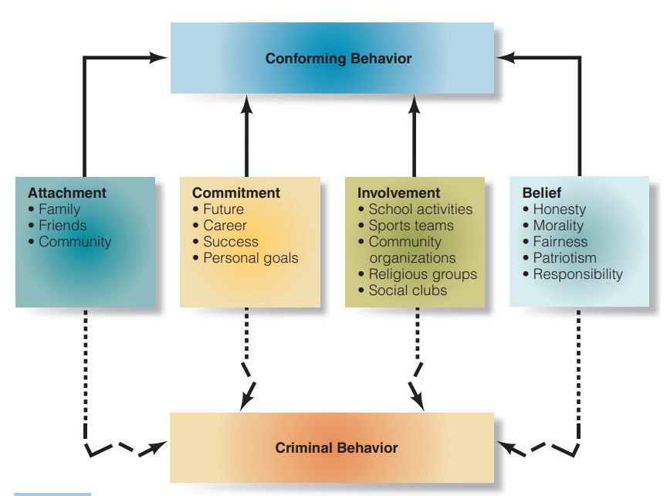
Social Process Theories
Social Control Theories
  Social control theorists argue that people obey the law because behaviors controlled by internal and external forces.
  Most people have developed a strong moral sense, which makes them incapable committing crimes.
  They develop a commitment to conformity i.e. obey the rules of society.
  Hirschi’s Social Bond Theory
    Travis Hirschi links the onset of criminality to the weakening of the ties that bind people to society.
    He assumes that all individuals are potential law violators, but they are kept under control because they fear that illegal behavior will damage their relationships with friends, parents, neighbors, teachers, and employers.
    Hirschi argues that the social bond a person maintains with society is divided into four main elements: attachment, commitment, involvement, and belief.
    Many criticisms but also many evidence of support on the theory of Hirschi.

Slide 58
Social Process Theories
Social Reaction Theory (Labelling Theory)
  Its roots are found in the symbolic interaction theory of sociologists Charles Horton Cooley and George Herbert Mead.
  Symbols are used by others to let people know how well they are doing. Wearing a Rolex and driving a Mercedes is a symbolic way of letting people know that you are quite successful.
  When someone takes another person’s life, it could be self-defense or cold-blooded murder, depending on how people interpret the act.
  The police officer who punches a suspect may, depending on how people interpret the incident, get a medal for subduing a dangerous criminal or be suspended for police brutality.
  People are labeled positively or negatively. Those who have accepted these labels are more prone to engage in deviant behaviors than those whose self-image has not been so tarnished.

Slide 59
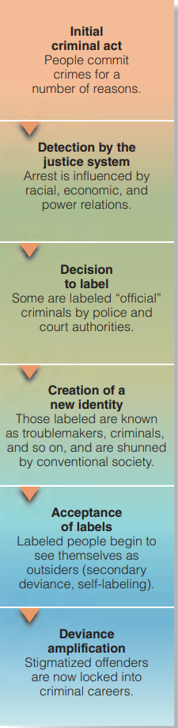
Social Process Theories
Social Reaction Theory (Labelling Theory)
  Different people interpret crime in different ways i.e. different juries might reach on different conclusions.
  An important principle of social reaction theory is that the law is differentially applied, benefiting those who hold economic and social power and penalizing the powerless e.g. Blessing got racially profiled.
  This labeling process is important because once they are stigmatized as troublemakers, adolescents begin to reassess their self-image.
  Concept of Primary and Secondary Deviance
    Primary Deviance is a crime that has little effect on the criminal e.g. if you steal a piece of gum and don’t get caught, it wont matter.
    Secondary Deviance is a crime that has impact on criminal because he got caught and reprimanded e.g. if you steal and get caught, you go to jail and waste important time of your life. Secondary deviance involves resocialization into a deviant role
  Labeling theory has been the subject of academic debate in criminological circles. Those who criticize it point to its inability to specify the conditions that must exist before an act or individual is labeled deviant—that is, why some people are labeled and others remain “secret deviants.”

Slide 60
Examples of Social Process Theories
Genarlow Wilson, aged 17 was convicted of molestation for having oral sex with a 15 year old girl due to the law. Even the court, prosecutor didn’t feel like he committed a crime – but that was the law. Genarlow Wilson was in fact labeled a sexual predator and sent to prison because those in power, who define the law and control its process, decided that his behavior constituted a serious crime, a felony.
Alpha Dog: Jesse, 25 marijuana dealer, kills a 15-year old and runs to Brazil. He was found by FBI and sent back to USA. Movie Alpha Dog is based on him.

Slide 61
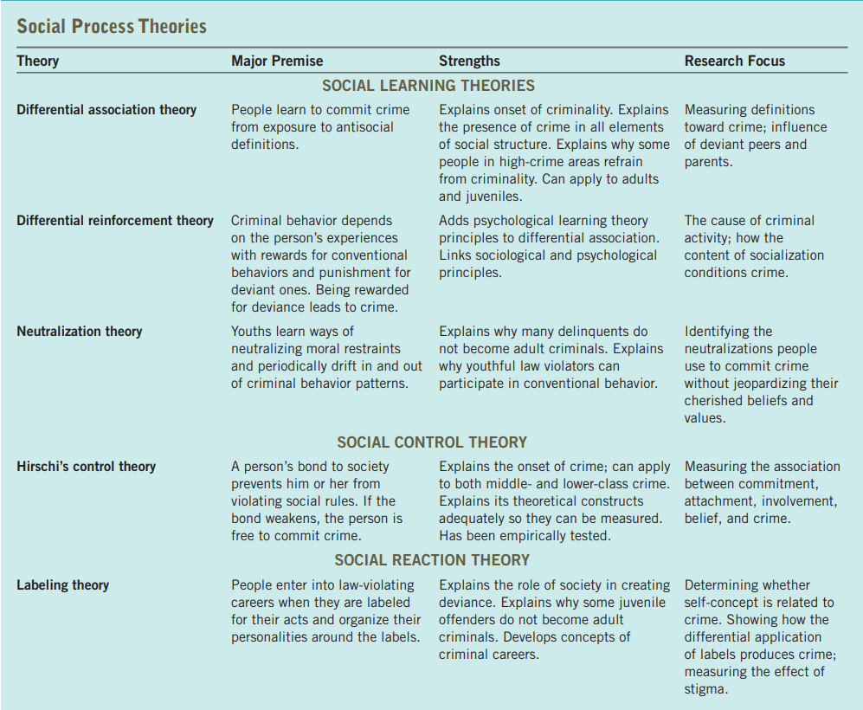
Social Process Theories - Summary

